Slide 1
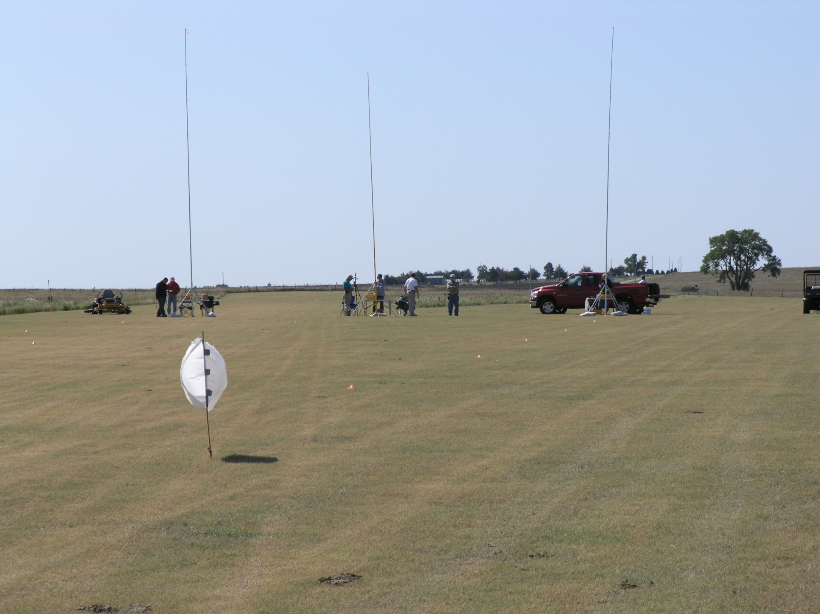
Field Test Comparisons of Drift Reducing Products for Fixed Wing Aerial Applications
Robert E. Wolf, Kansas State University, Manhattan, Kansas • Scott Bretthauer, University of Illinois, Urbana, Illinois • Dennis R. Gardisser, University of Arkansas, Little Rock, Arkansas
ABSTRACT
Ten drift control products were compared for reducing horizontal and vertical drift for a high-speed fixed wing aerial application scenario. Water-sensitive paper and DropletScan™ software was used to collect and compare the differences in drift.
Differences in amounts of drift were found among all treatments.
A few of the products exhibited less drift potential than water alone.
Several of the products exhibited the same or more drift potential than water alone.
Slight differences were measured in how the products affected the droplet size (VMD).
INTRODUCTION
Off-target drift is a major source of application inefficiency. Application of crop protection products with aerial application equipment is a complex process. In addition to meteorological factors, many other conditions and components of the application process may influence off-target deposition of the applied products. Spray formulations have been found to affect drift from aerial applications. Materials added to aerial spray tank mixes that alter the physical properties of the spray mixture affect the droplet size spectrum. With new nozzle configurations and higher pressure recommendations, and with the continued development of drift reducing tank mix materials, applicators seek to better facilitate making sound decisions regarding the addition of drift control products into their tank mixes.
OBJECTIVE
This study evaluated the influence of selected drift control products/deposition aids on horizontal, vertical, and total spray drift during a high-speed fixed wing aerial application scenario.
AT 501A
Drop booms
CP-11TT #15 nozzles w/8° deflection
44 psi
156 mph ground speed by radar
Droplet Spectrum: Medium (CP/USDA Model)
Percent Volume < 200 microns = 7.65%
Aircraft calibrated for 28 L/ha (3 GPA)
RESULTS
EQUIPMENT AND PRODUCTS
Volume Median Diameter
Figure 3. Treatment volume median diameter’s.
Figure 1. Air Tractor 502A.
Horizontal Drift
Product Name | Company | Mixing Rateª
Tap water 1 | Local supply | X-77 only
Superb HC + Interlock | Winfield Solutions | 133 oz + 33 oz / 50 gal
Formula 1 | United Suppliers | 1.5 qt / 50 gal
#PX056-Z | Precision Labs, Inc | 5 qt / 50 gal
Tap water 2 | Local supply | X-77 only
Ag 06037 | Winfield Solutions | 64 oz / 50 gal
Ag 08050 | Winfield Solutions | 80 oz / 50 gal
Interlock 1.25 | Winfield Solutions | 80 oz / 50 gal
Control | GarrCo Products, Inc | 2 oz /50 gal
Tap water 3 | Local supply | X-77 only
INT 908 | Rosen’s | 5 gal / 45 gal
Tap water + Prime Oil^{b} | Local supply + Winfield Solutions | 266 oz / 50 gal
Interlock 0.8 | Winfield Solutions | 50 oz / 50 gal
% Area Coverage
Vertical Towers
Figure 4. Horizontal drift summary.
Flight Line
Vertical Drift
Horizontal Collectors
% Area Coverage
Three vertical towers extended 40 feet and located 300 feet downwind from the flight line.
WSP positioned at 5-foot increments up the tower.
WSP on horizontal collectors located on 50-foot increments away from flight line and toward the towers.
ª All tank mixes included X-77 at .25% v/v (16 ounces per 50 gallon load).
^{b} Oil to simulate a suggested tank mix with fungicide (Prime Oil @ 1 pint/acre).
Figure 2. Horizontal and vertical drift collection towers.
Figure 5. Vertical drift summary.
Total Drift
% Area Coverage
CONCLUSIONS
Differences in coverage representing downwind drift were measured at all horizontal and vertical collector positions for all the treatments.
INT 908, Control, and Interlock 0.8 all were measured with significantly less drift than the average of the three all water treatments.
A water and oil treatment also had less drift than the average of the water treatments.
The remainder of the products were measured with more drift than the water only average.
Based on mixing, loading, and system cleanout evaluations, some products may hinder good application techniques.
Figure 6. Total drift summary.
Ranked Total Drift
% Area Coverage
water average
Figure 7. Total drift rank.

