Slide 1
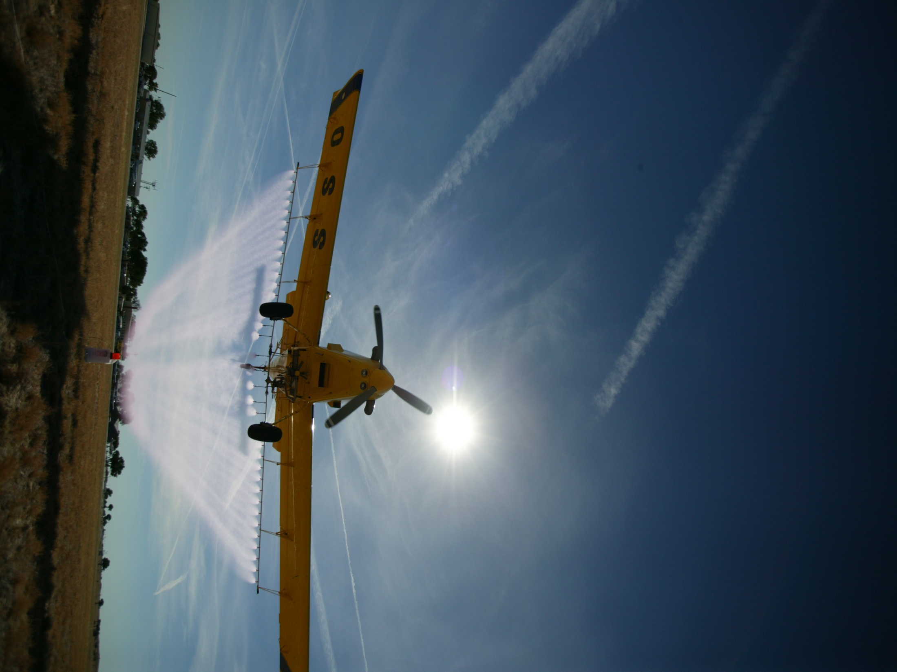

For more information contact:
rewolf@ksu.edu
www.bae.ksu.edu/faculty/wolf/

Slide 2


Nozzle Design Update
Robert E. Wolf
Extension Specialist Application Technology
Biological and Agricultural Engineering
Notes:
Use either title slide. Hide the one you do not want to use.

Slide 3
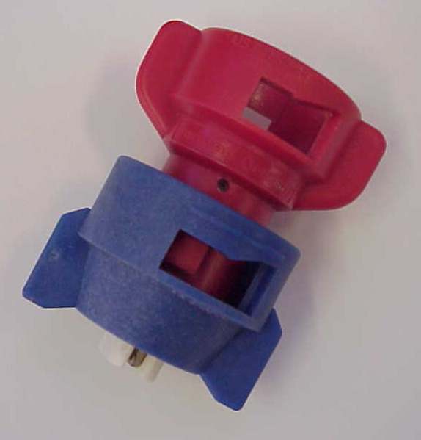
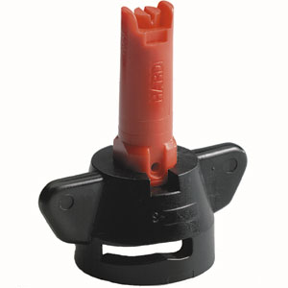
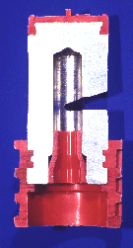
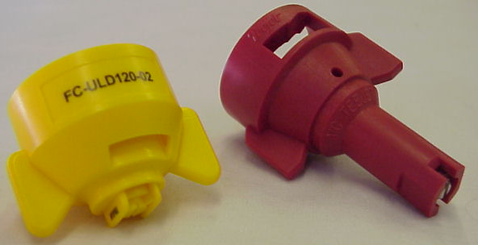
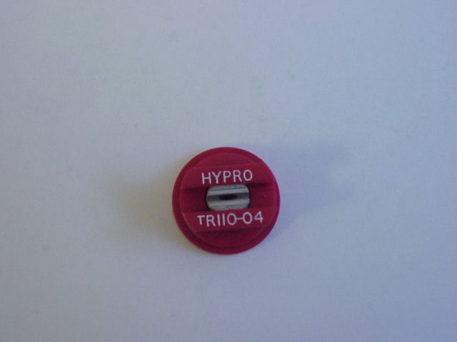
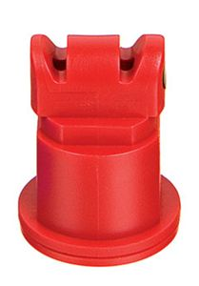
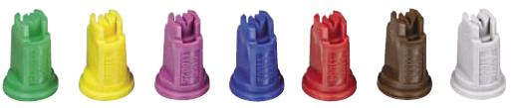
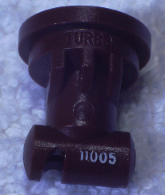
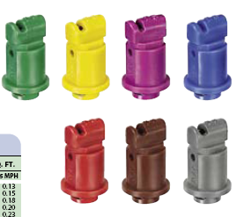
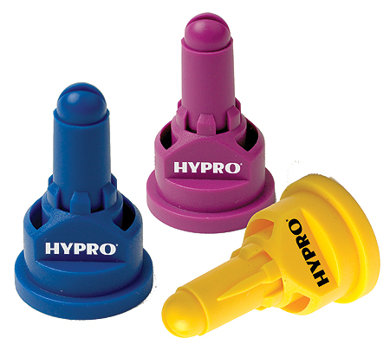
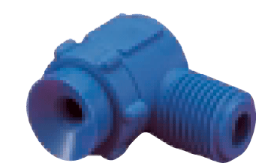
Nozzle Technology……
Nozzles designed to reduce drift
Improved drop size control
Emphasis on ‘Spray Quality’
Notes:
Beginning with the ‘extended range’ flat fan nozzle (all major manufactures have one), continuing with the design of ‘preorifice inserts’ and ‘turbulation chambers’, and now with the ‘venturi’ style nozzle design, nozzle manufacturer's have worked to develop nozzles that are improving the quality of spray emitted.

Slide 4
Nozzle Efficacy/Drift Slope
1980
30 years
Reducing Spray Drift
Extended Range
Nozzle development timeline
XR, TR
Turbo Flood
Turbo TeeJet
Air Mix
AI XR
GuardianAir
AI
Ultra Low Drift
Turbo Drop
TTI
Chamber Design
Venturi Design - II
Venturi Design - I
Efficacy
2009

Slide 5
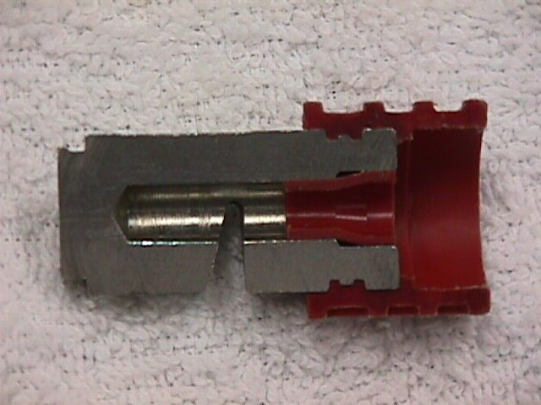
Nozzles Types?
air induced
Flat Spray Patterns
flat-fan
chamber
Notes:
Beginning with the ‘extended range’ flat fan nozzle (all major manufactures have one), continuing with the design of ‘preorifice inserts’ and ‘turbulation chambers’, and now with the ‘venturi’ style nozzle design, nozzle manufacturer's have worked to develop nozzles that are improving the quality of spray emitted.

Slide 6
Extended Range Flat-fan:

Slide 7
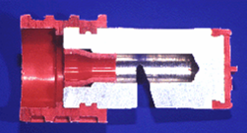
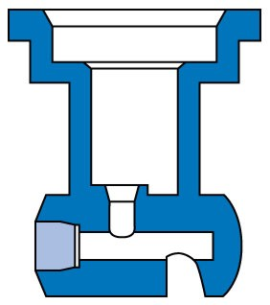
Turbo Flat-fan:
Pre-orifice
Turbulence chamber as in the Turbo Flood
Tapered edge, wide angle flat pattern
Designed to work in flat-fan nozzle holder
Uniform spray distribution, 50-60% overlap
Wide pressure range, 15 – 90 psi
Large, drift resistant droplets
Plastic with superior wear characteristics
Exit orifice
Notes:
18

Slide 8
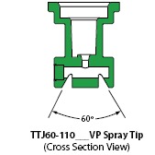
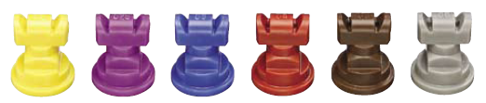
New release in 2006:
See Page 10, TeeJet Catalog 50A
Dual outlet
Superior leaf coverage
Droplet range slightly larger that comparable TT flat-fan
Turbo TwinJet

Slide 9
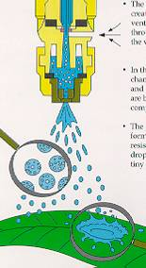
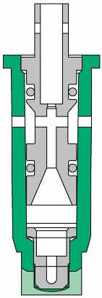

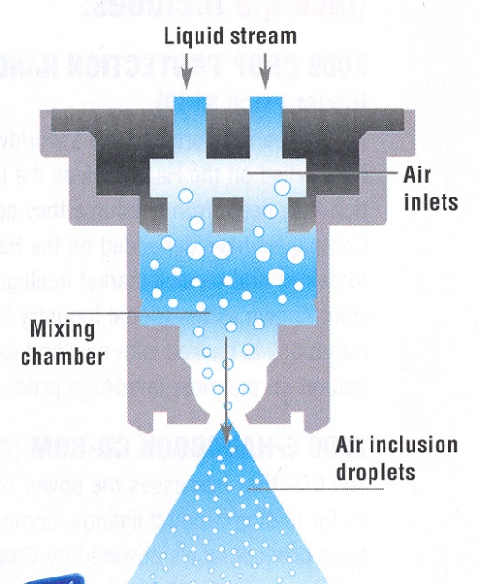
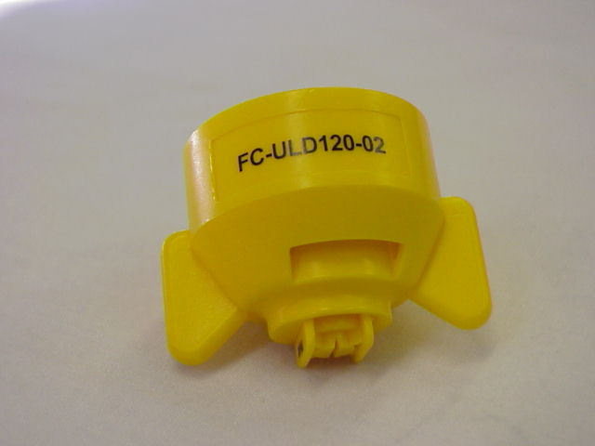
Pre-orifice Venturi Nozzles(1st generation)
Pre-orifice
Air induction
Mixing Chamber
Exit orifice

Slide 10
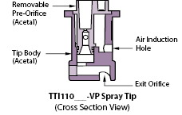
2nd Generation Venturi Nozzles:
See Page 11, TeeJet Catalog 50A
More compact
Larger drops
Operates at lower pressures
Percentage of fines do not increase with pressure
Turbo Injection - TTI
AITTJ60
Turbo TwinJet Induction

Slide 11
3rd Generation Venturi Nozzles

Slide 12
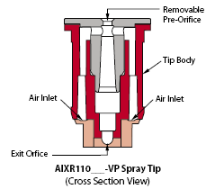
New release in 2007:
See Page 14, TeeJet Catalog 50A
XR outlet with venturi air aspirator design
More compact than AI style
2-piece with removable pre-orifice
AIR INDUCTION XR TeeJet

Slide 13
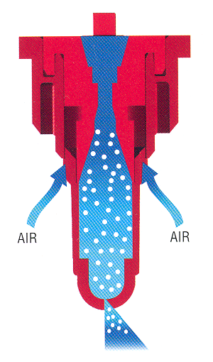
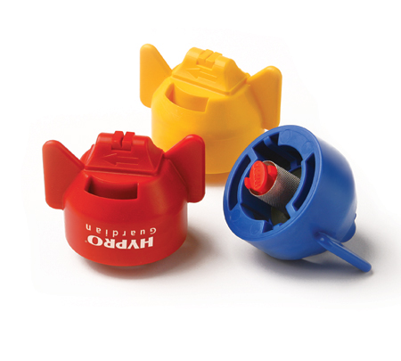
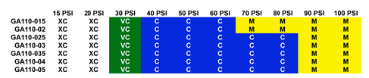
GuardianAir Induction:
More consistent droplet
All-in-one cap and screen
Wide angle with 15 degree incline toward the rear
Aim forward or rearword – alternate?
See Page 16, Hypro Spray Tip Guide
GuardianAir

Slide 14


Slide 15
New Nozzles
AITTJ60
Turbo TwinJet Induction
Turbo TwinJet – TTJ60
AI XR TeeJet
GuardianAir - Hypro

Slide 16
Demo

Slide 17
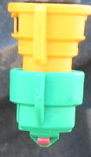
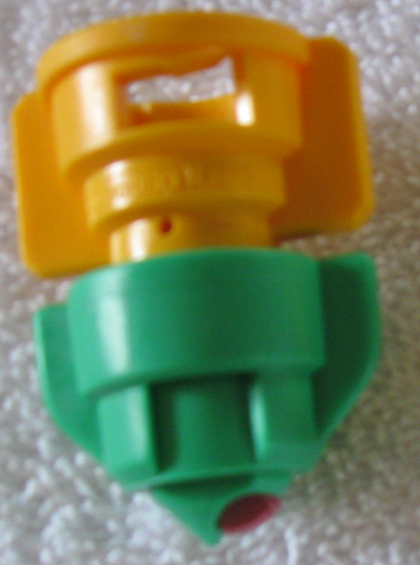
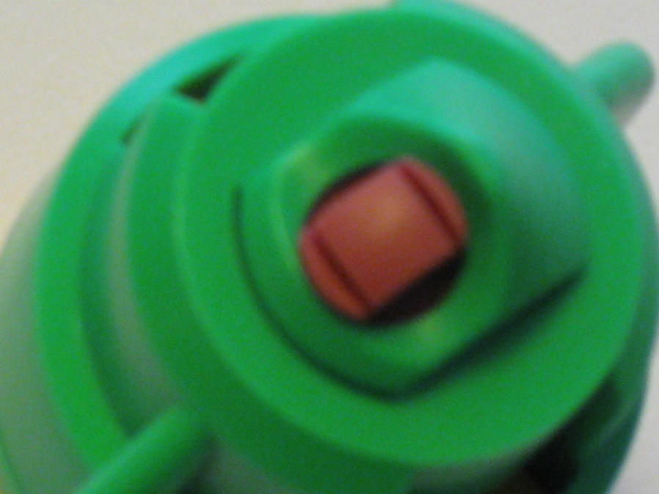
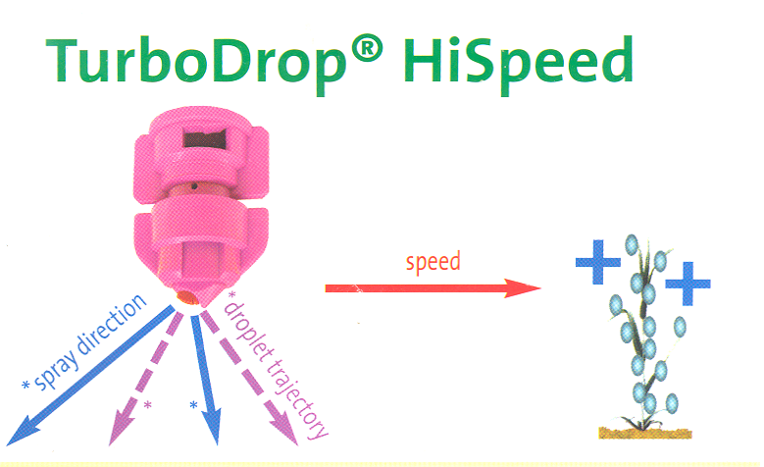
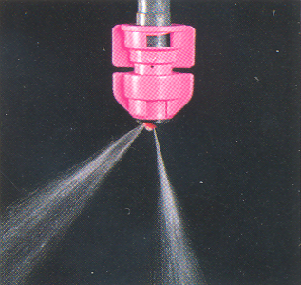


Slide 18

Nozzles-Recommended Use
flat spray
20-25 PSI
chamber
30-40 PSI
IN BETWEEN VENTURI
40 PSI
air induced/venturi
50-80 PSI
Notes:
Beginning with the ‘extended range’ flat fan nozzle (all major manufactures have one), continuing with the design of ‘preorifice inserts’ and ‘turbulation chambers’, and now with the ‘venturi’ style nozzle design, nozzle manufacturer's have worked to develop nozzles that are improving the quality of spray emitted.

