Slide 1


Revising the ASABE S-572 Droplet Standard and Its Practical Use
Robert E. Wolf
Extension Specialist Application Technology
Biological and Agricultural Engineering
Notes:
Use either title slide. Hide the one you do not want to use.

Slide 2
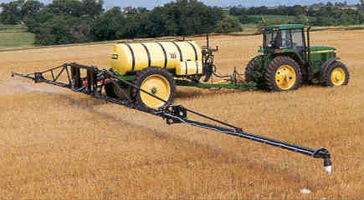
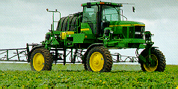
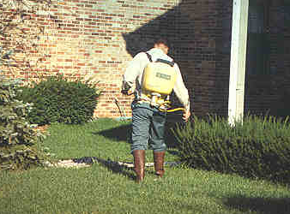
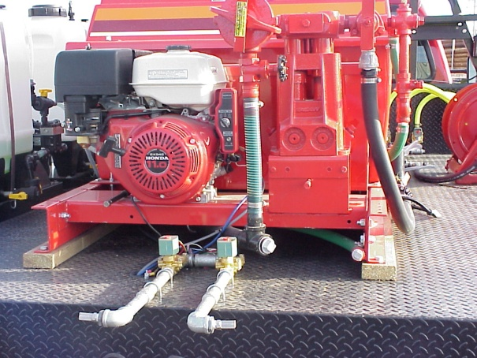
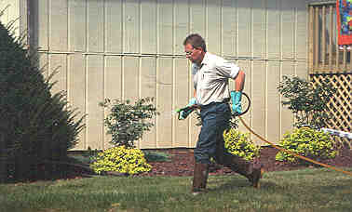
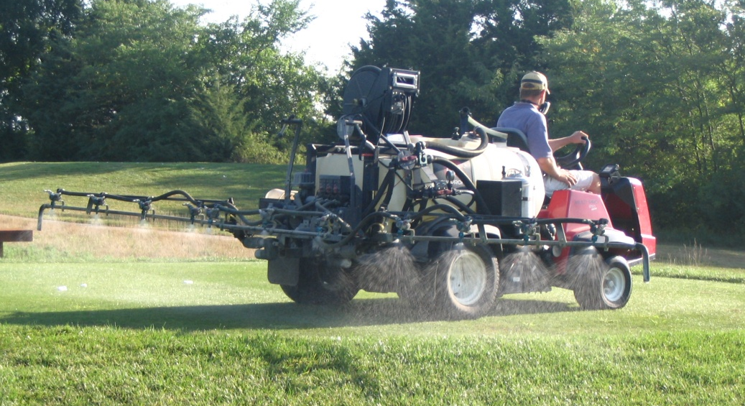
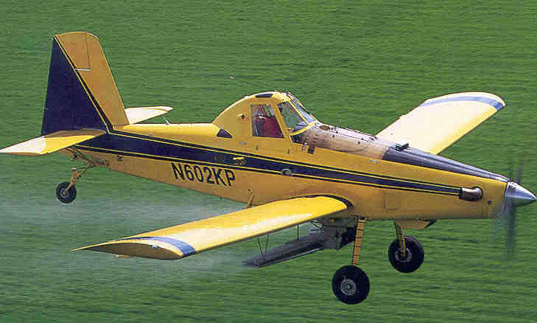
Notes:
Cost range from $10K – $30K for farmer, golf course, and road side sprayers. Obviously will very greatly dependant on how set up.
Commercial sprayers will range from $50 to $250K. Really some variation with these systems from Spra-Coupe and Appache types all the way to the Rogator, Case-IH, and John Deere systems. New 800 gallon turbine powered Air Tractor (150 MPH spray speed) could run close to $1.5 million today. The above picture is a 600 gallon version. AT is building a new 1025 gallon version.

Slide 3
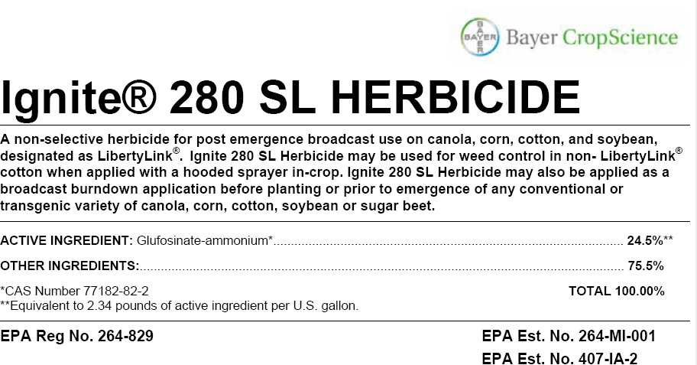
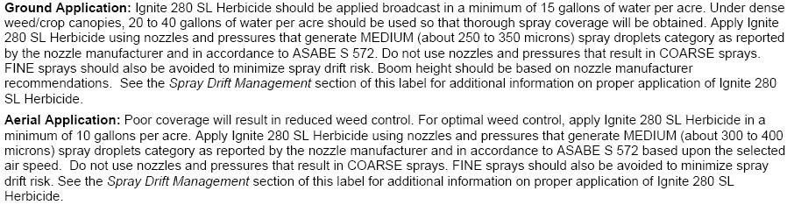

Slide 4
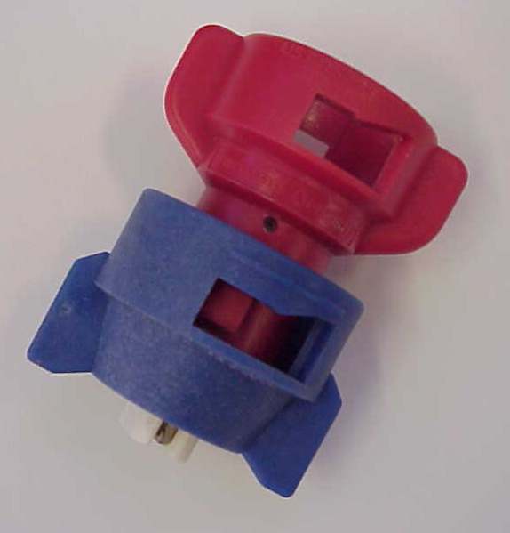
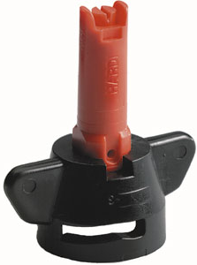
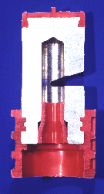
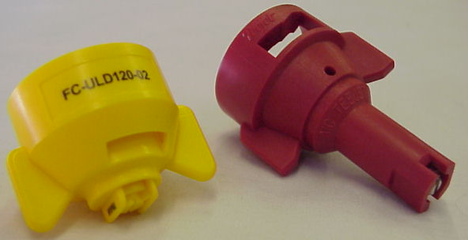
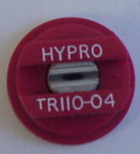
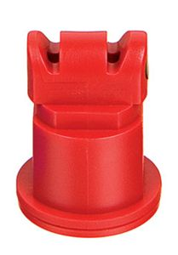
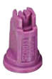
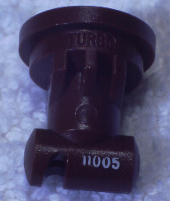
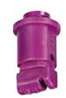
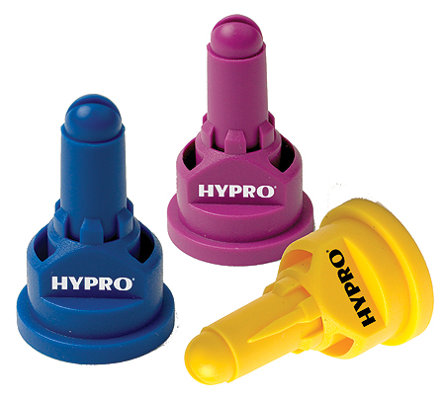
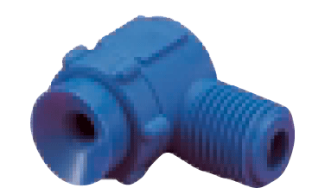
Nozzle Technology……
Nozzles designed to reduce drift
Improved drop size control
Emphasis on ‘Spray Quality’
Notes:
Beginning with the ‘extended range’ flat fan nozzle (all major manufactures have one), continuing with the design of ‘preorifice inserts’ and ‘turbulation chambers’, and now with the ‘venturi’ style nozzle design, nozzle manufacturer's have worked to develop nozzles that are improving the quality of spray emitted.

Slide 5
Nozzle Efficacy/Drift Slope
1980
30 years
Reducing Spray Drift
Extended Range
Nozzle development timeline
XR, TR
Turbo Flood
Turbo TeeJet
Air Mix
AI XR
GuardianAir
AI
Ultra Low Drift
Turbo Drop
TTI
Chamber Design
Venturi Design - II
Venturi Design - I
Efficacy
2009

Slide 6
Droplet Size Classification for Agricultural Sprays
Safe and efficient application requires a definition of an appropriate droplet size spectrum:
  Maximize spray efficiency for transporting crop protection product to the target.
  Minimize off-target losses via:
    Spray drift
    Applicator exposure
Spray performance and drift minimization depends on droplet size.
Because of a multitude of nozzle types - sprays should be classified according to droplet size.

Slide 7
Origin Of Standardized Spray Droplet Size Categories - Europe
1985 – British Crop Protection Council (BCPC)
  Spray classification system
    Primarily designed to enhance efficacy
    Originally for nozzles for ground spray applications
    Other atomizers also included
  Uses the term SPRAY QUALITY for droplet size categories.
Quality of spray placed in five categories:
  very fine, fine, medium, coarse, very coarse
Recognized that droplet size spectra was different when measured by different instruments and techniques.
  Laser diffraction, optical imaging, phase-Doppler
  Sampling techniques with instrumentation

Slide 8
Origin Of Standardized Spray Droplet Size Categories – United States
1999 – ASAE Standard S572 (revised 2009-S572.1)
  Defines droplet spectrum categories for the classification of spray nozzles.
  Classified relative to specified reference nozzles discharging spray into static air so that no stream of air enhances atomization.
  Droplet size classifications are primarily designed to indicate off-site spray drift potential.
  Secondarily used for application efficacy.
Standard is a means for relative nozzle comparisons only based on droplet size.
  Does not address droplet trajectory, height, and velocity; air bubble inclusion; droplet evaporation; and impaction of target.

Slide 9
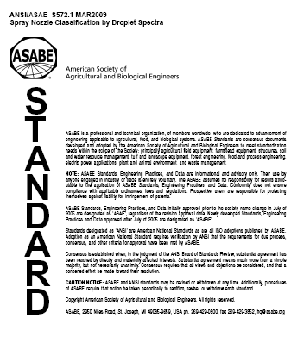
2009
ASABE S-572.1 Droplet Size Standard

Slide 10

www.asabe.org

Slide 11
Spray Nozzle Classification by Droplet Spectra
Liquid flow rate, liquid pressure, and physical changes to nozzle geometry and operation can affect the nozzle classification.
  Nozzle can be classified into multiple categories.
  Would depend on flow rate, operating pressure, etc.
Based on spraying water through a reference nozzle compared to the nozzle being classified.
Spray liquid properties may affect droplet sizes
  Consider using surfactant-water mixtures
  Always consider the ‘finer’ classification if comparing water and water with surfactant mixes.

Slide 12
ASAE Reference Nozzle and DSC for a Selected Nozzle Operation = Medium
MEDIUM
MEDIUM
COARSE
Source: Buddy Kirk
Notes:
To help us understand how the ASAE standard is applied, this graph shows the performance curves for the ASAE reference nozzles, ranging from the 6510 nozzle at the top of the graph that separates XC from VC to the 10F110 nozzle at the bottom of the graph that separates F from VF. The red curve is the performance curve for a selected aerial nozzle. The ASAE standard says the DSC is determined by the finer of its position at the three points on the curve. In this case, the DSC for the selected aerial nozzle operation would be M even though it is in the C category at the small end of the spray droplet spectrum.

Slide 13
Spray quality categories.
ASABE Standard S-572.1
Category (symbol) | Color Code
Extra Fine (XF) | Purple
Very Fine (VF) | Red
Fine (F) | orange
Medium (M) | yellow
Coarse (C) | Blue
Very Coarse (VC) | Green
Extra Course (XC) | White
Ultra Coarse (UC) | Black
2009
NEW
S572
NEW

Slide 14

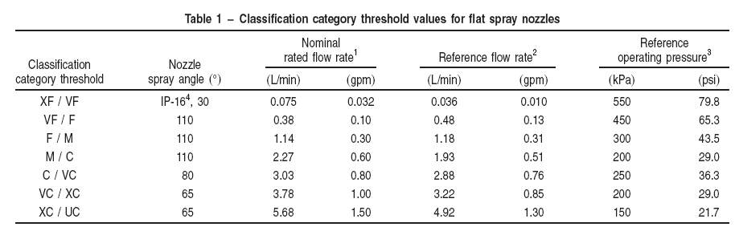
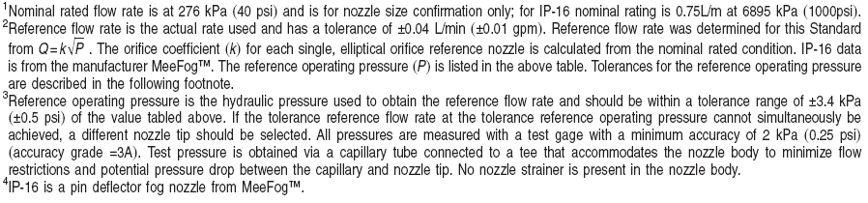

Slide 15
Droplet Sizing
Measured with a laser-based instrument.
  Both reference and nozzles to be classified
Commercial droplet sizing instruments typically use techniques with:
  Laser diffraction
  Laser imaging
  Laser-based phase Doppler
Verification and calibration to known standards essential.
Nozzle oriented to scan the entire spray plume.
Ensure a representative cross-sectional sample of the spray plume is obtained.

Slide 16
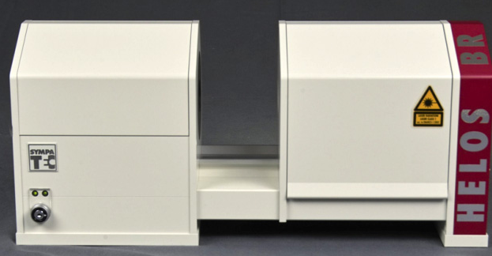
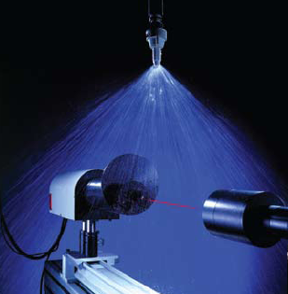
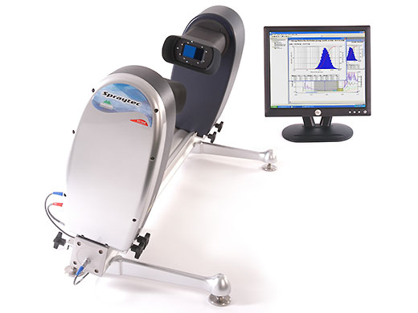
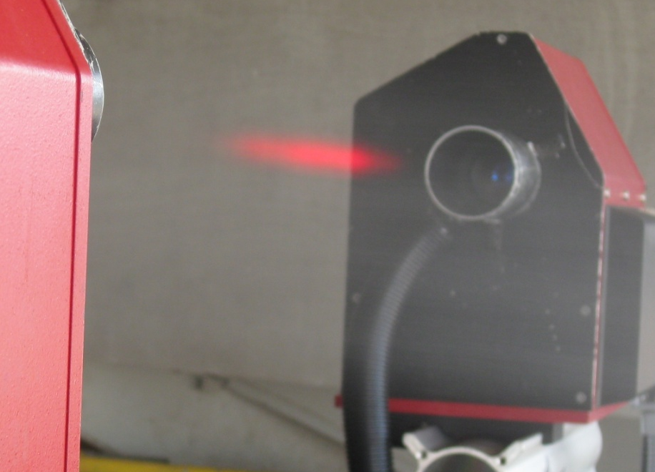
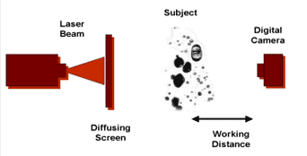

Slide 17
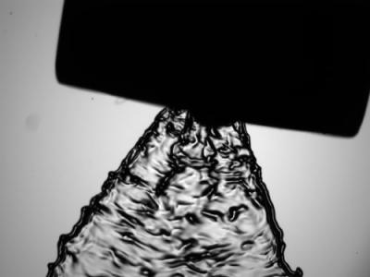

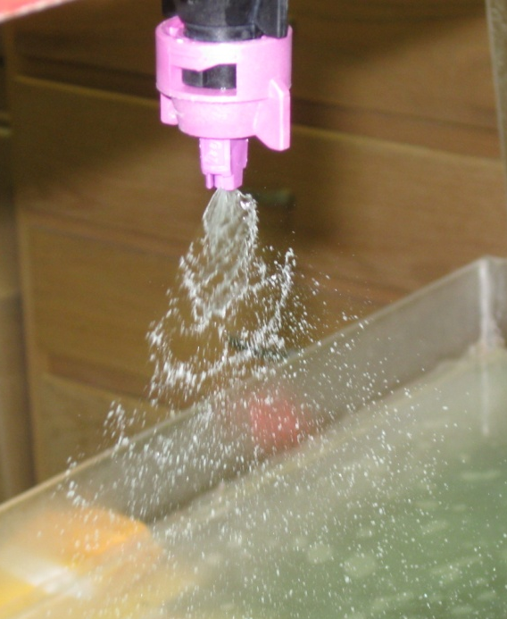


Slide 18
Droplet Sizing
Determine a reference graph from the reference nozzles.
Create example reference graph by plotting droplet diameter (microns - µm) vs. the cumulative spray volume (fraction or %).
Curves will define the classification thresholds between categories.

Slide 19
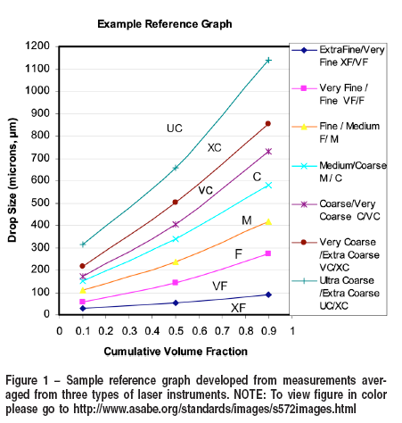

Slide 20
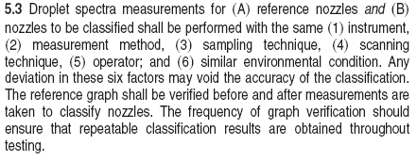
Standard says:

Slide 21
Practical Uses for S-572.1
Manufacturers can have their nozzles tested by a qualified technician using the proper equipment and techniques as outlined in S-572.1.
Manufactures can do in-house testing provided they follow the specifications outlined in S-572.1.

Slide 22
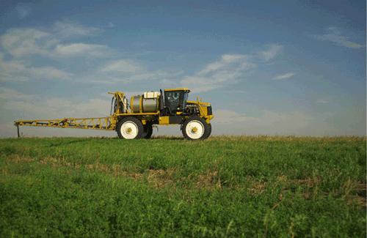
How can the applicators use this standard for day to day applications?

Slide 23
- 15 GPA
- Generate MEDIUM spray droplets (ASABE S-572)
-Do not use nozzles and pressures that result in COARSE sprays

Slide 24
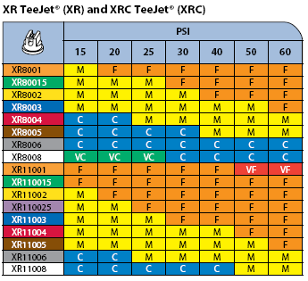
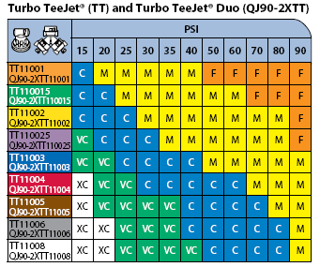
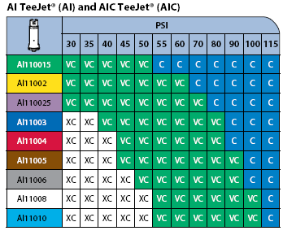
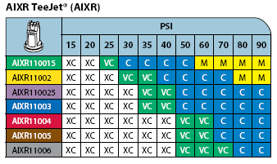

Slide 25
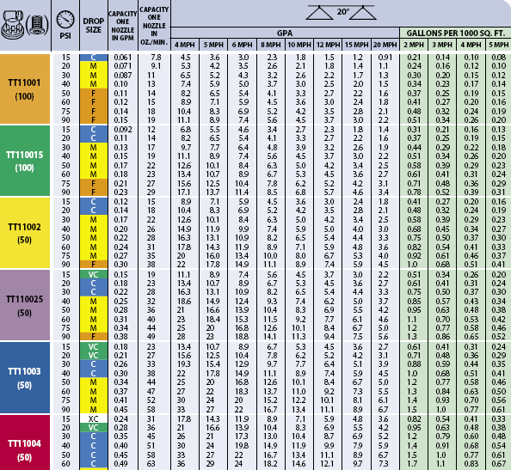

Slide 26
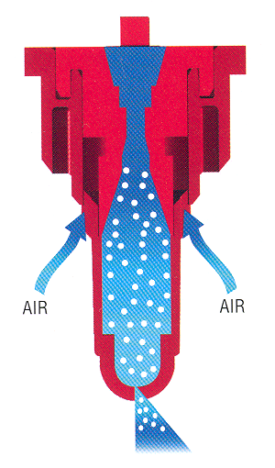
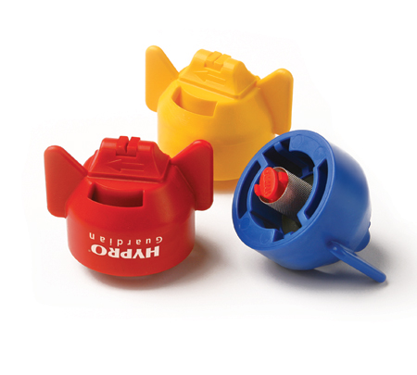
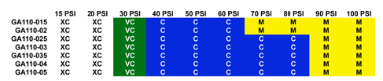
Hypro –
GuardianAir Induction
More consistent droplet
All-in-one cap and screen
Wide angle with 15 degree incline toward the rear
Aim forward or rearword – alternate?
See Page 16, Hypro Spray Tip Guide
GuardianAir

Slide 27
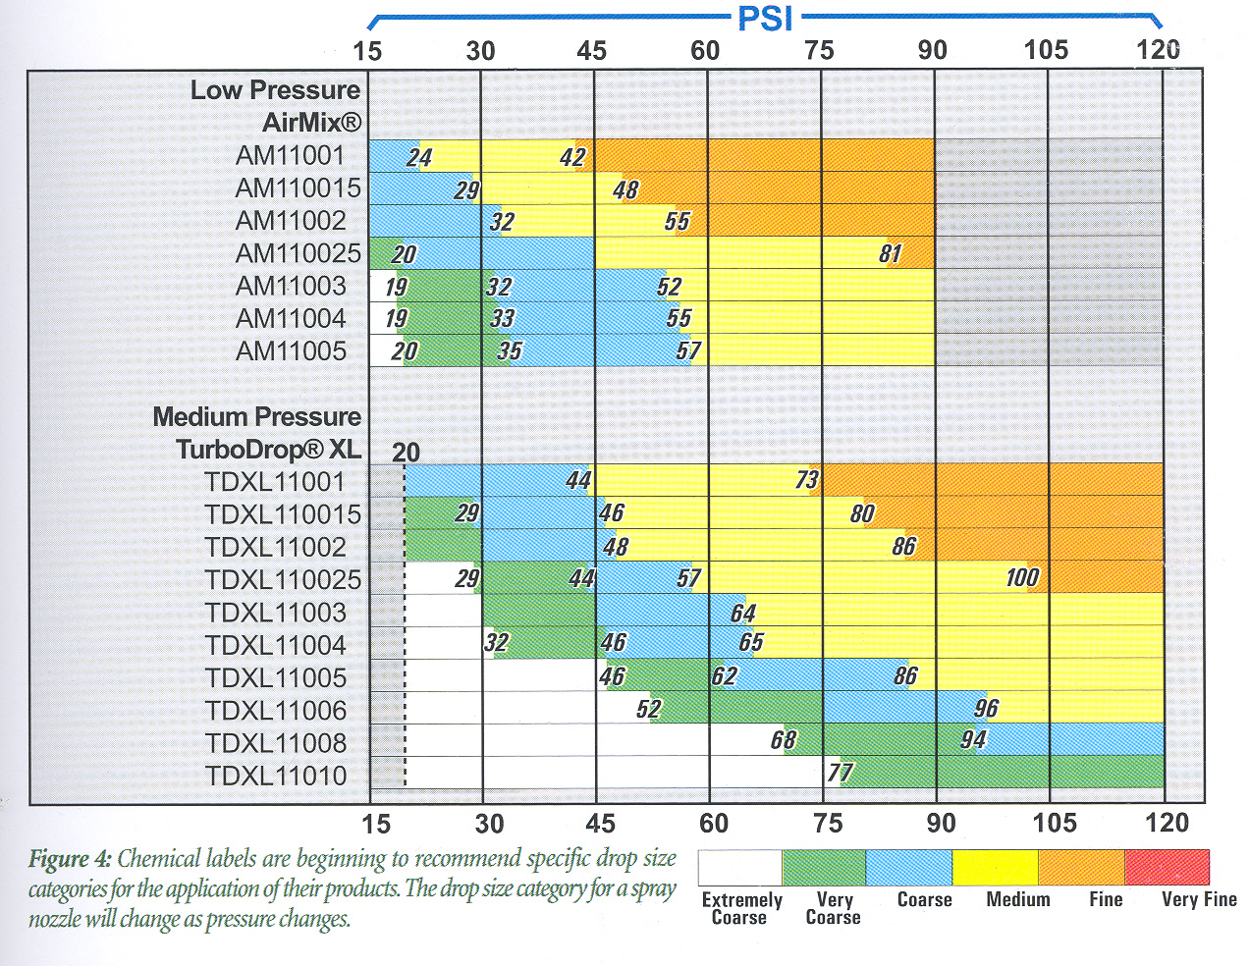
Greenleaf Droplet chart:
www.turbodrop.com

Slide 28
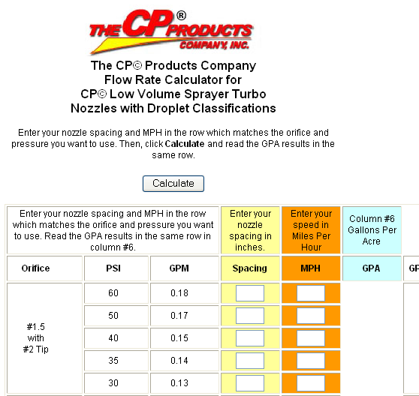
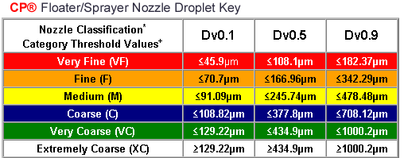
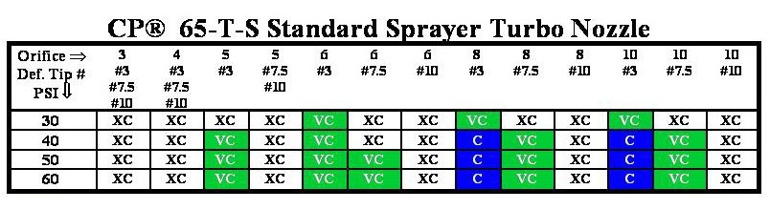

Slide 29
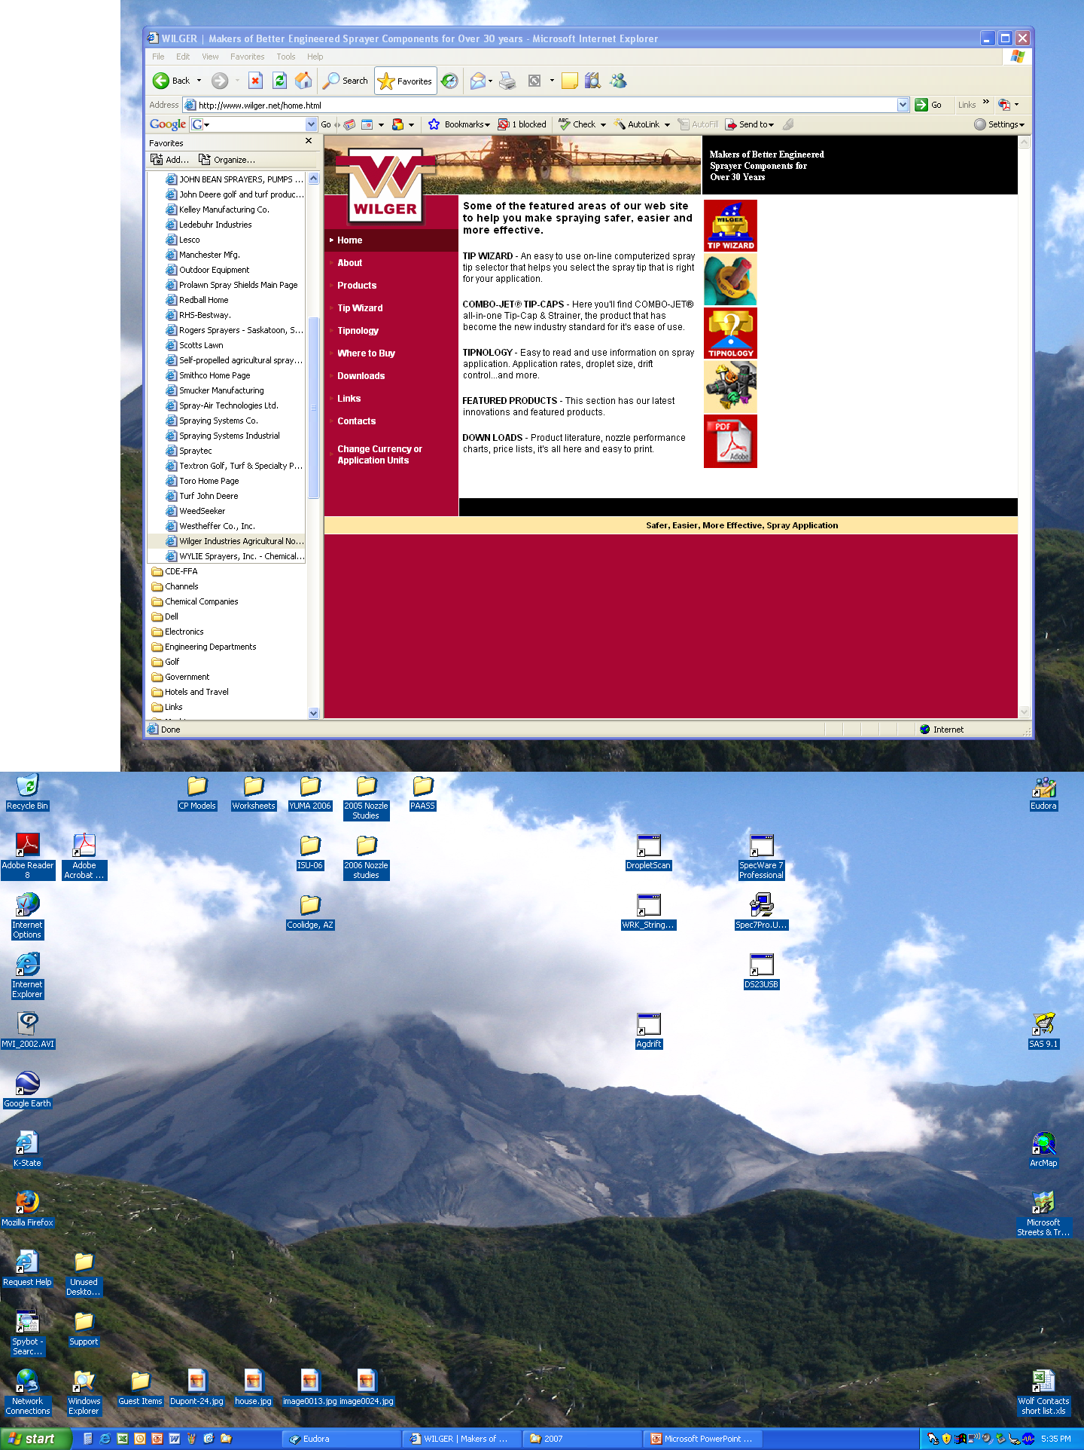
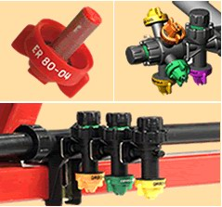

Slide 30
Calibration!!!!
The next phase!
A new concept for applicators!
Ensuring that the spray droplet spectrum is what it is supposed to be to maximize efficacy while minimizing drift!

Slide 31
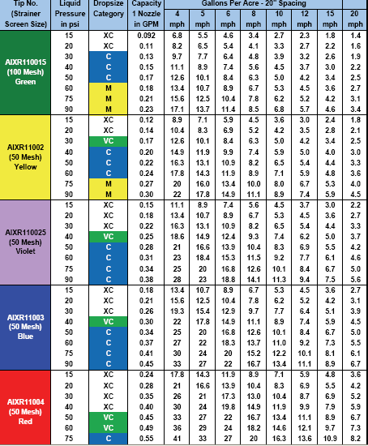
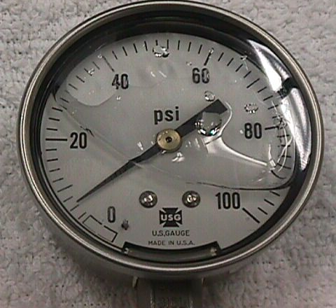
Selecting the proper nozzle….
Page 9, 12, 14, 15
Calculate GPM (formula)
Look under GPM column
Match to pressure-psi
Choose the size needed
Operate at given pressure and speed used in formula to achieve GPA
.30
Notes:
Select the pressure to suit the nozzle type. Bigger the orifice the lower the pressure. Pressure gage is used to emphasize that the pressure should be monitored at the nozzle for the most accurate flow rate measurement.

Slide 32
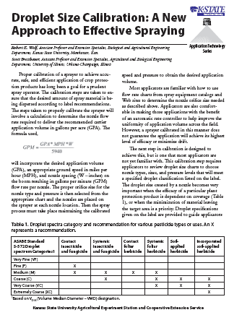


Fact Sheet: MF2869
www.bae.ksu.edu/faculty/wolf/

Slide 33






Droplet Characteristics Solutions - Sympatec Laser - College Station

Slide 34


CP11TT4015 Flat-Fan
140 MPH
40 PSI
23 degree orientation

Slide 35



ASC D-12 Rotary Atomizer
140 MPH
26 PSI
2 GPA
Blade pitch #2

Slide 36




Droplet
Characteristics
Water
Oxford Laser
Wooster

Slide 37




Droplet Characteristics-Solutions
Sympatec Laser
North Platte

Slide 38







Droplet Characteristics
Water Sensitive & Kromekote Paper – KSU

Slide 39






Droplet Characteristics –
Spread Factors – Solutions
College Station

Slide 40


Slide 41
Disclaimer:
Brand names appearing in this presentation are for identification and illustration purposes only.
No endorsement is intended, nor is criticism implied of similar products not mentioned.

Slide 42



rewolf@ksu.edu
For more information contact:
www.bae.ksu.edu/faculty/wolf/

