Slide 3
Protect Sensitive Crops: Being a Good Neighbor
Carefully select a pesticide product.
Read the label.
Follow all precautions on the label.
Watch for drift or runoff.
Store pesticides in their original containers.

Slide 4
How do pesticides move away from the application site?
Particle drift (spray or dust)
During the application – small droplets and wind
After the application – inversions and wind
Vapor drift – evaporate/volatilize off plants
Formulation, ie. 2,4-D
High temperatures
Low humidity
Runoff – applications to a slope, on bare ground, or before a rain

Slide 5
Use Pesticides Carefully
Sensitive plants
Many plants and animals (people) are sensitive.
Grapes, cotton, soybeans, fruit and nut trees
Hormonal-type pesticides
2,4-D, dicamba, picloram, MCPA, triclopyr, fluroxypur, mecoprop
Effect can be miles away
Also, insecticides may kill bees

Slide 7
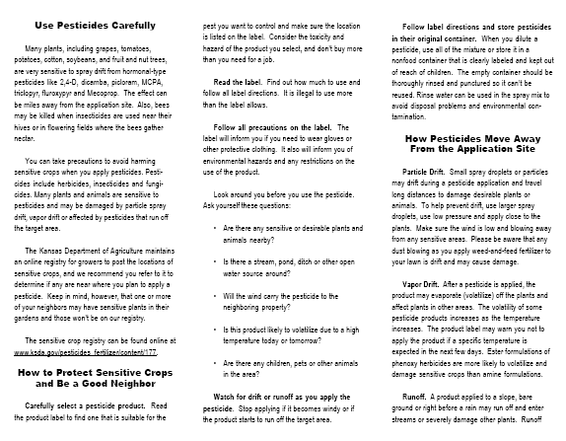

Slide 8
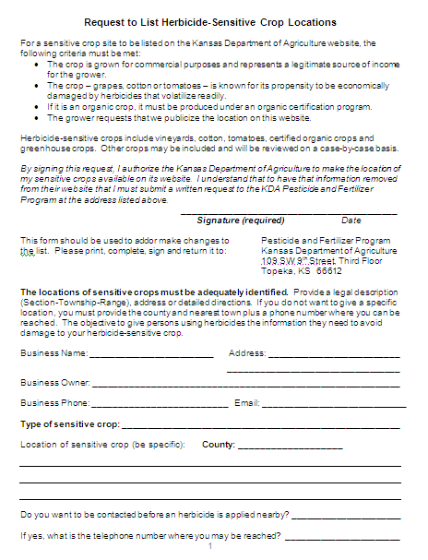
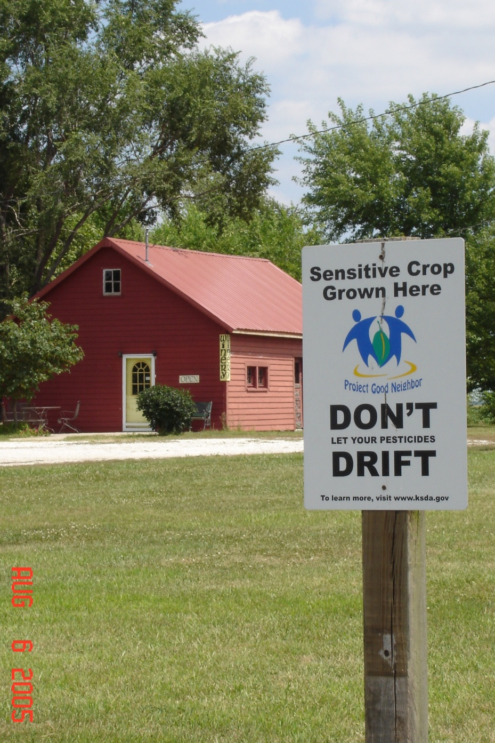

Slide 9
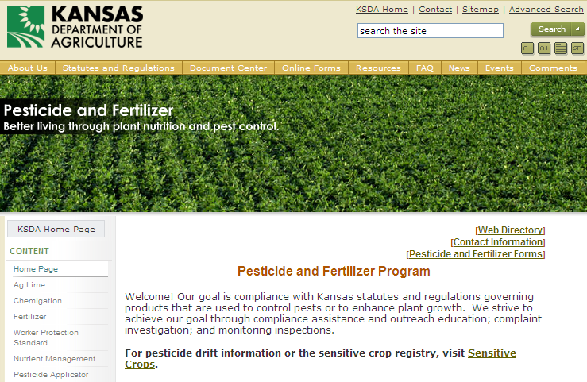
http://www.ksda.gov//

Slide 10
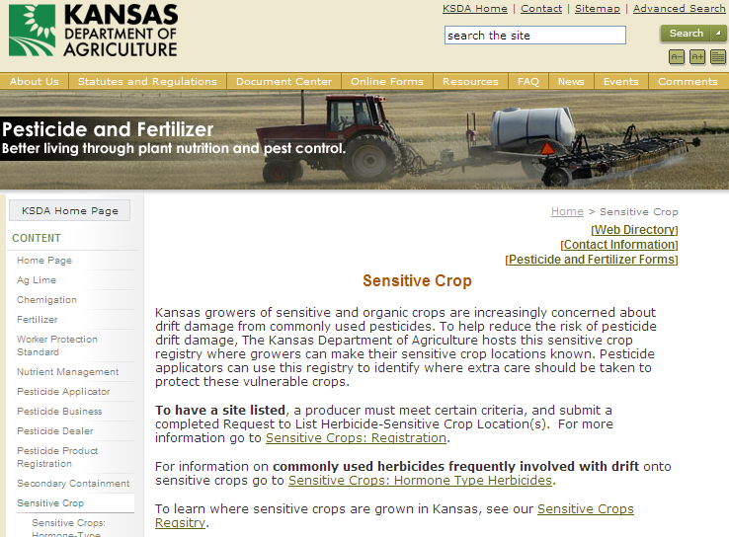

Slide 11
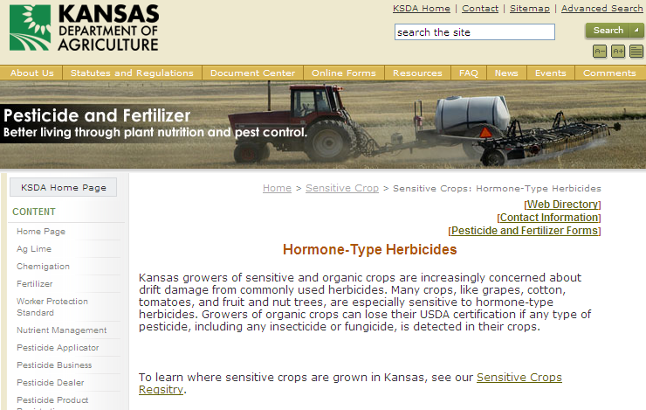
http://www.ksda.gov//

Slide 12
Plant Response 1/100 Rate of 2,4-D Simulated as Drift 14 Days After Exposure
Percent injury
Kassim Al-Khatib, Kansas State University

Slide 13
Cotton Response 1/100 Rate 2,4-D Simulated as Drift 14 Days After Exposure
Percent injury
Kassim Al-Khatib, Kansas State University

Slide 14
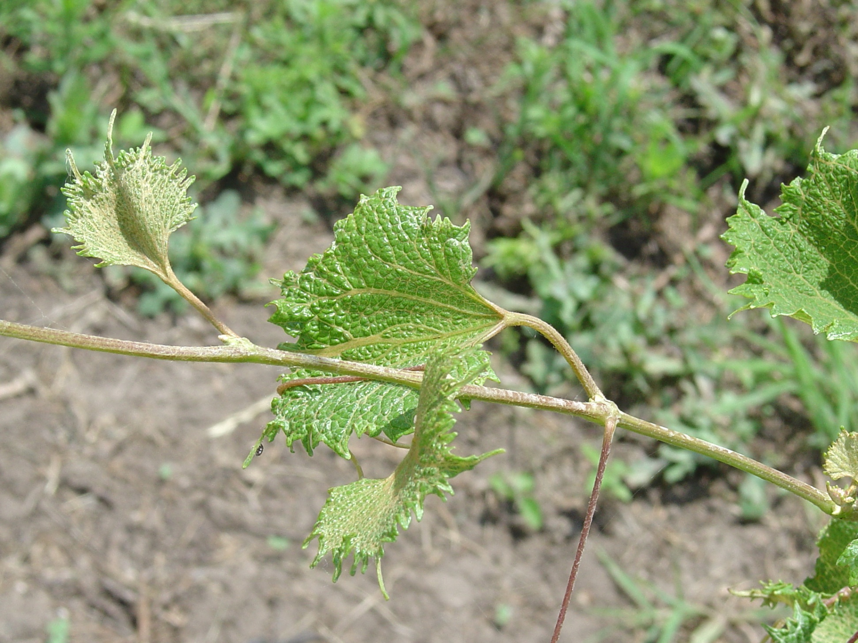

Slide 15
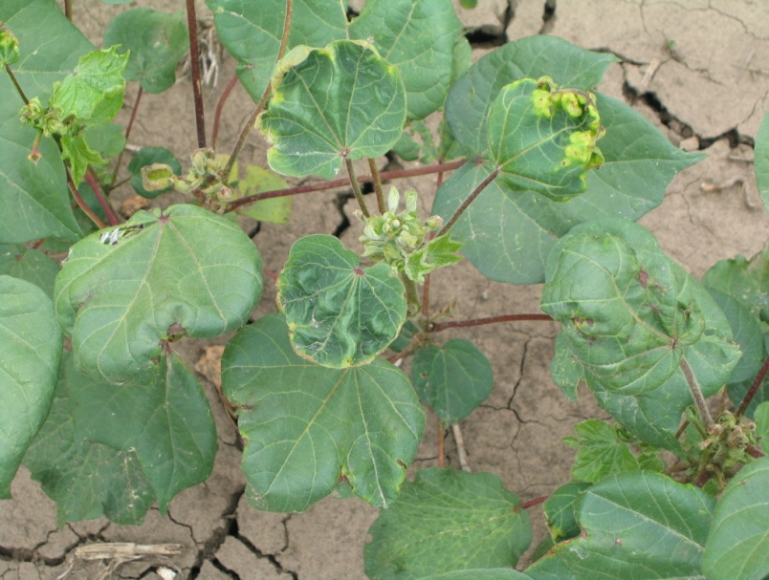
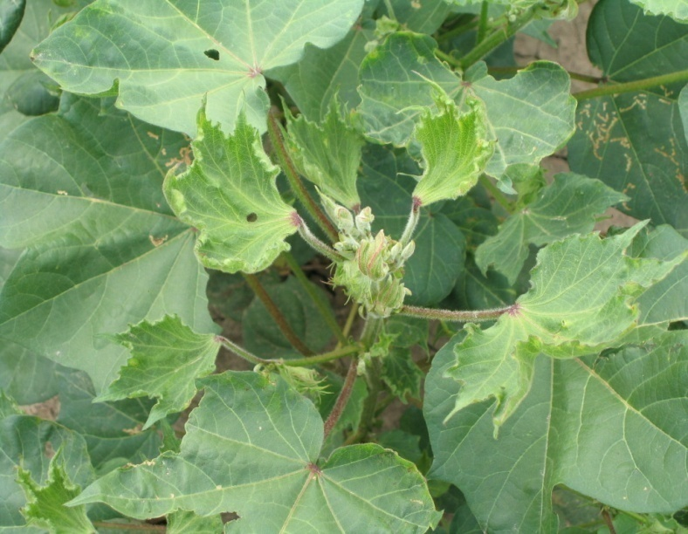
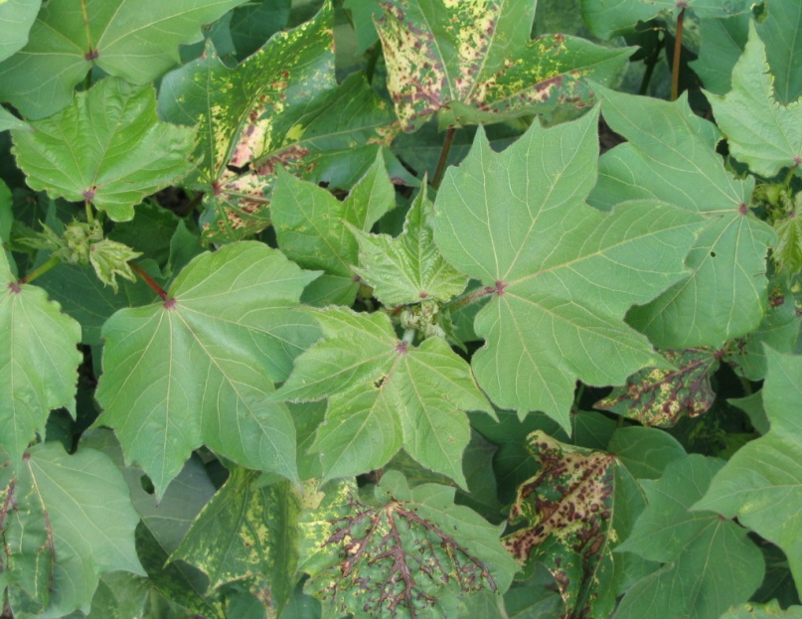
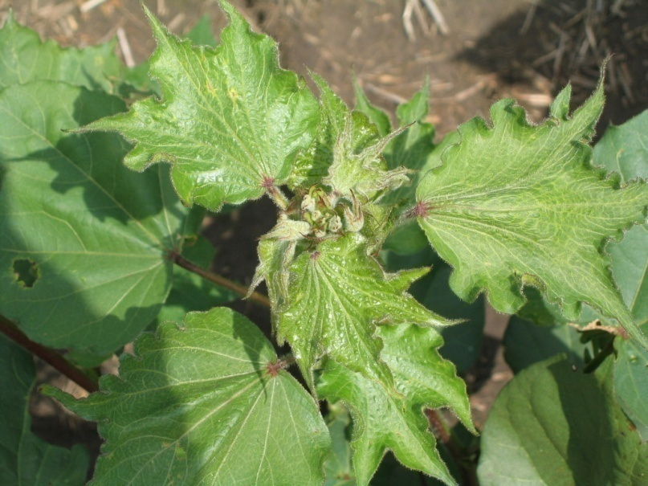
Picloram
2,4-D
Triclopyr
Fluroxypyr

Slide 16
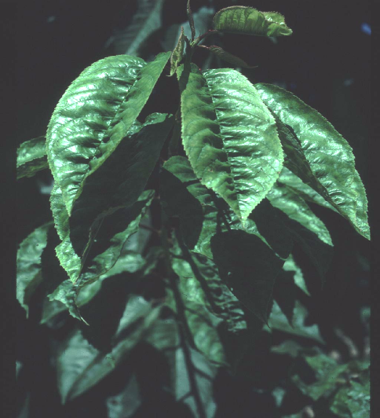
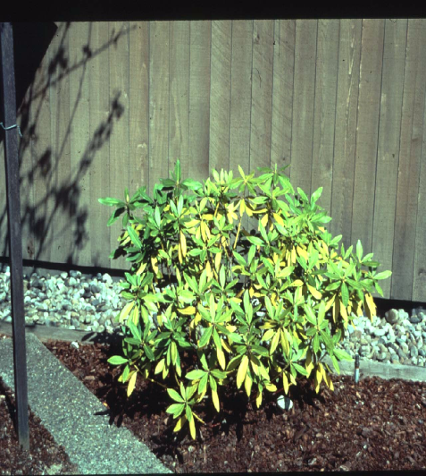
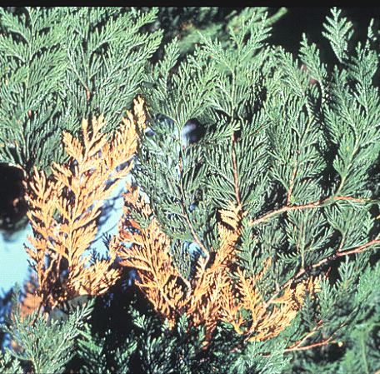
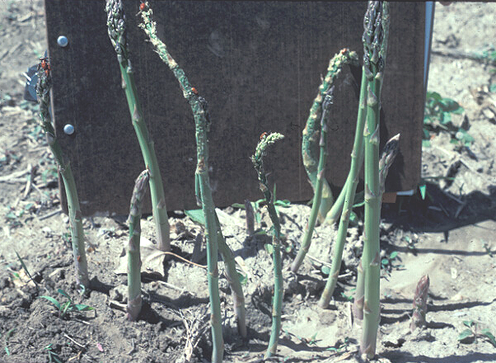

Slide 17
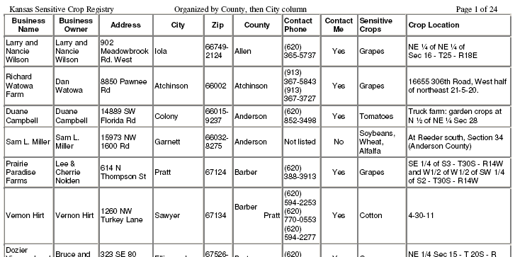

Slide 18
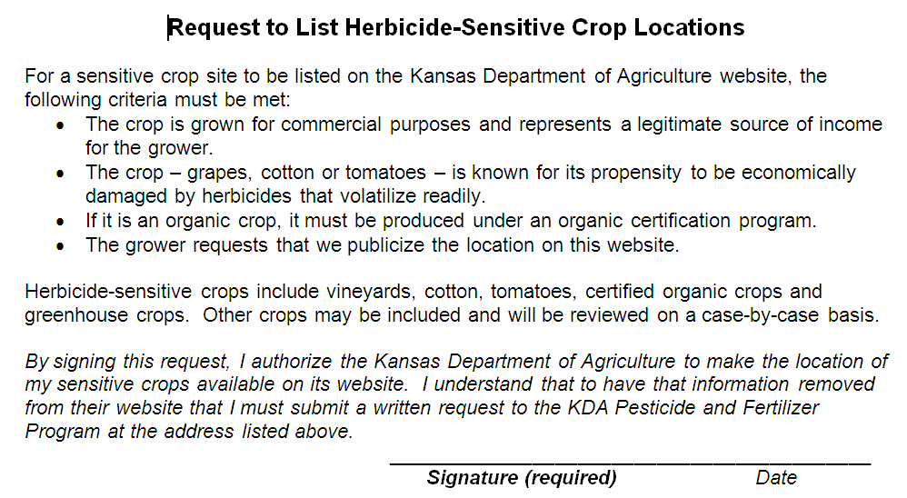

Slide 19
