Slide 1
Understanding Label Language and the Implications for Application
Robert E. Wolf
Extension Specialist Application Technology
Biological and Agricultural Engineering
Notes:
Use either title slide. Hide the one you do not want to use.

Slide 2
Changes in the Application Industry!
Product Related!!!
Historically inefficient process
Increased cost of pesticides
Product rates are changing (< an ounce/acre)
More pest specific products
Biotechnology and GMO’s (Roundup Ready, Bt’s)
More sophisticated equipment (electronics) $$$
Variable rates
Site-specific
Focus on Drift
Notes:
4
2

Slide 3
Remember
to
Always

Slide 4
Looking At Labels
Label instructions are enforceable
Label information is required on records
Labels require applicators to comply with Worker Protection Standard regs
Some language is enforceable, while other is advisory – which is which?
Some language details how to prevent damage to crops, protect nearby sites, and achieve quality pest control
Notes:
Both state regulatory agencies and EPA do enforcement on pesticide use. Another little recognized enforcement arm are state Health and Safety agencies that enforce on the Worker Protection Requirements.
It is really a challenge, even for state regulators to tell what language an applicator MUST legally follow and what language is only advisory in nature and not actually enforceable.
From the perspective of the legal/court…….
Today we are seeing more and more details on the label the provided instructions to ensure proper deposition, minimize off-target movement, provide no-spray zones, detail tank cleaning procedures, and more
The goal of this presentation is to review some of the more subtle label language and remind you on why it is important to read the labels of those products you will apply PRIOR to the spray season – when you have time to catch the fine print.

Slide 5
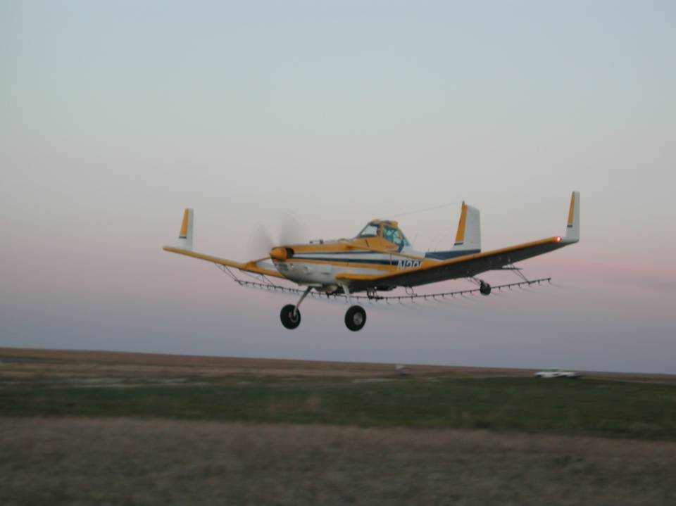
Pesticide Labeling
Your safety as well as the safety of other people and the environment all depend on reading and understanding the label.
Label violations lead to fines and significant legal problems. Ignorance of the label is never considered an adequate defense if enforcement action is taken against you.

Slide 6
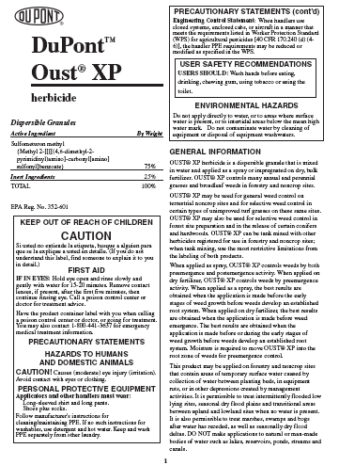
The Label Starts Here!
Notes:
Contains information critical to using the product effectively and safely.
Include detailed information on safety precautions (human and environmental)
Not following the label instructions is a violation of Federal and/or State law.
Labels have various sections as mandated by the Environmental Protection Agency (EPA).
It is extremely important that you familiarize yourself with the labels of the products you use (especially the first few pages and the crop specific information).
Don’t take it for granted that this year’s label is the same as last year’s, they are changing often these days.

Slide 7
Label Sections
The trade name does not tell you what is in the product
Go to the active ingredients section
The EPA registration number and trade name are required for pesticide recordkeeping.
Notes:
Certain information found on the label must be recorded on your application records. One of the more common recordkeeping errors is that applicators write in the active ingredient name when it is the Trade name that is required. Make sure you write in the Trade name.

Slide 8
Label Interpretation
What is advisory?
What is mandatory?
What is enforceable - Regulatory?
What is enforceable – Litigation?
Notes:
The purpose of the following slides will be to review various label statements not for the purpose of discussing the techniques but to better understand how to interpret them…..
Key words will be highlighted in the various examples provided.
Presenters are encouraged to avoid a detailed discussion of techniques. Many of these topics have been covered in previous spray drift minimization modules.
Use this opportunity to establish with members of the audience what some of the label issues are that they are concerned about.

Slide 9
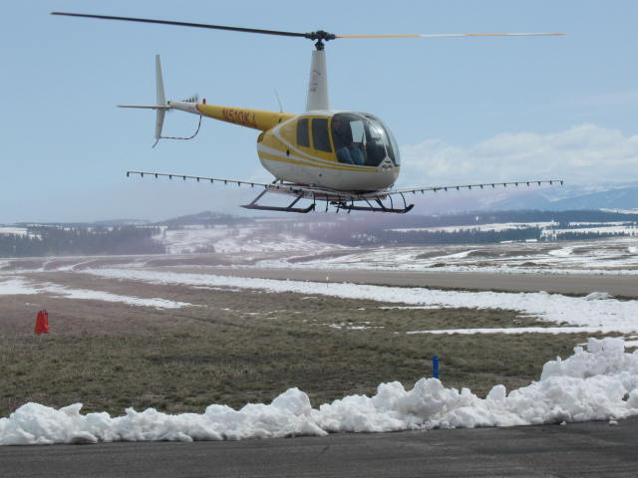
Spray Drift Management
Statements on the Label

Slide 10
Aerial Application Instructions
Notes:
This slide has multiple levels and is an example of statements provided to aerial applicators about drift. The key reference on many labels today directs applicators to the Aerial Drift Reduction Advisory. In particular this slide a specific state has special requirements. The following slides will take us through some of the key components of such an advisory.

Slide 11
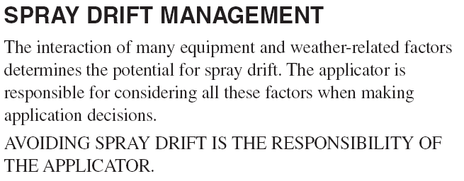

Slide 12
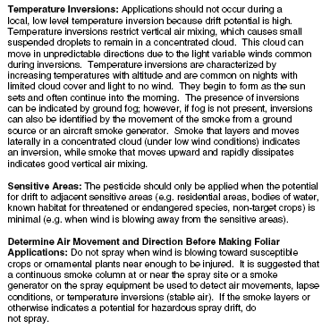
ADVISORY
Notes:
THIS SLIDE IS HIDDEN AND INSERTED TO SHOW THE LAYERS OF INFORMATION THAT ARE NOT APPARENT ON SLIDE 41 IN THE INSTRUCTOR’S GUIDE.
This slide shows the Aerial Drift Reduction Advisory pages again.
Some labels have drift advisories. Main slide is the Grazon P+D label and covers most all concerns about drift causing elements. The the expanded size slides are taken from the Harmony Extra XP label. Again do not focus to intently on the techniques but you must emphasis that statements made on the label are non-enforceable, but if you end up in litigation on an application you may have to explain why you didn’t follow the advisory.

Slide 13
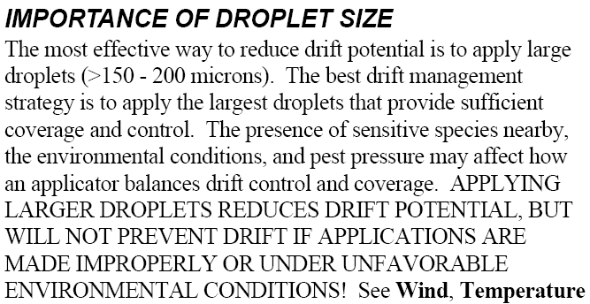
ADVISORY
Notes:
THIS SLIDE IS HIDDEN AND INSERTED TO SHOW THE LAYERS OF INFORMATION THAT ARE NOT APPARENT ON SLIDE 41 IN THE INSTRUCTOR’S GUIDE.
This slide shows a statement about the “Importance of Droplet Size”.
Some labels have drift advisories. Main slide is the Grazon P+D label and covers most all concerns about drift causing elements. The the expanded size slides are taken from the Harmony Extra XP label. Again do not focus to intently on the techniques but you must emphasis that statements made on the label are non-enforceable, but if you end up in litigation on an application you may have to explain why you didn’t follow the advisory.

Slide 14
ADVISORY
Notes:
THIS SLIDE IS HIDDEN AND INSERTED TO SHOW THE LAYERS OF INFORMATION THAT ARE NOT APPARENT ON SLIDE 41 IN THE INSTRUCTOR’S GUIDE.
This slide illustrates the suggestions for “Controlling Droplet Size – General Techniques” through Volume, Pressure, and Nozzle type.
Some labels have drift advisories. Main slide is the Grazon P+D label and covers most all concerns about drift causing elements. The the expanded size slides are taken from the Harmony Extra XP label. Again do not focus to intently on the techniques but you must emphasis that statements made on the label are non-enforceable, but if you end up in litigation on an application you may have to explain why you didn’t follow the advisory.

Slide 15
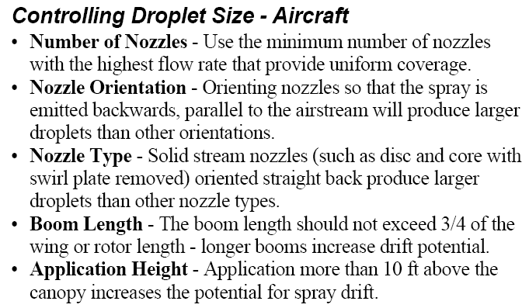
ADVISORY
Notes:
THE LAST 3 HIDDEN SLIDES HAVE BEEN ILLUSTRATING WHAT APPEARS AT THE VARIOUS LEVELS OF THIS SLIDE.
This slide shows the final slide illustration of “Controlling Droplet Size – Aircraft” through the Number of Nozzles, Nozzle Orientation, Nozzle Type, Boom Length and Application Height.
Some labels have drift advisories. Main slide is the Grazon P+D label and covers most all concerns about drift causing elements. The the expanded size slides are taken from the Harmony Extra XP label. Again do not focus to intently on the techniques but you must emphasis that statements made on the label are non-enforceable, but if you end up in litigation on an application you may have to explain why you didn’t follow the advisory.

Slide 16
Droplet Size
Coarse droplets
300 to 500 microns
For herbicides: do not
use fine droplet sprays
Not less than 600 microns VMD
Notes:
Many labels are starting to include specific information regarding droplet size for the crop protection product being used. Some excerpts from several labels are included in this slide. Note how some are becoming very specific. Also note that the label requiring 600 microns or larger may be a challenge to achieve….ie check out using the models for your given application parameters.
Also note in the one case that an incorrect/mistake had been made. VD 0.9 should be VD 0.1. The VD 0.1 represents the small driftable fines typically identified in the less than 200 micron range.
Note the variety of ways droplet size can be described. Some labels use specific micron sizes, others refer to the VMD, VD0.1 and VD0.9, while still others use the ASABE S-572 droplet spectra classification system.

Slide 17
Label Restrictions & Limitations
Do not apply this product by air earlier than 30 minutes prior to sunrise or later than 30 minutes after sunset……Fresno County Ag Commissioner
Notes:
Stam M-4
Glyphosate 41%
Glyphosate 41%
Clincher CA

Slide 18
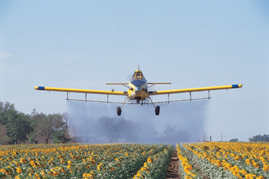
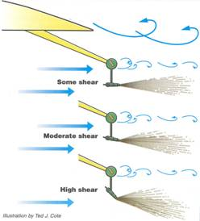
Label Restrictions and Limitations
WRONG?
Notes:
What constitutes excessive speed or pressure? Optimal application speed varies from aircraft to aircraft. Optimal pressure depends on several factors, including speed, nozzle type, orifice size, and spray angle. As for the 25 psi limit, we know in many cases increasing pressure actually increases droplet size (remind them about nozzle models), but this label specifically prohibits higher pressures. Participation in an Operation S.A.F.E. fly-in can verify that your aircraft performs well at the speed and pressure you typically apply at.

Slide 19
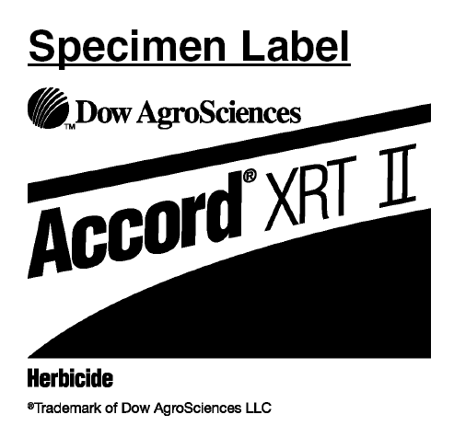

Slide 20
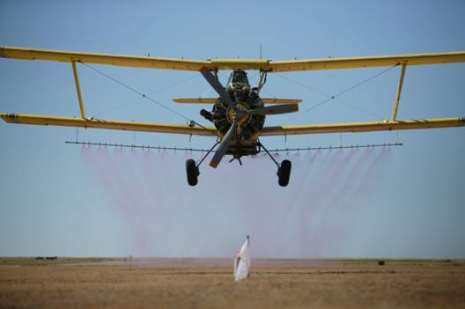
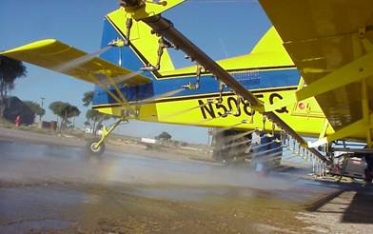
Calibration
Notes:
Does having nozzles of all the same orifice size evenly spaced along the boom assure an accurate and uniform application? Think about your nozzle spacing on the outer edges of your boom compared to the center section – is the number of nozzles and spacing the same? Again, participation in an Operation S.A.F.E. fly-in can verify your aircraft provides a uniform pattern with non-uniform nozzle spacing. Bottom label specifically mentions pattern testing.

Slide 21
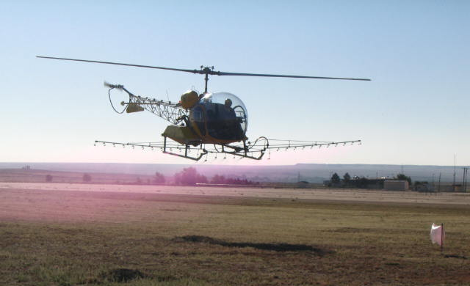
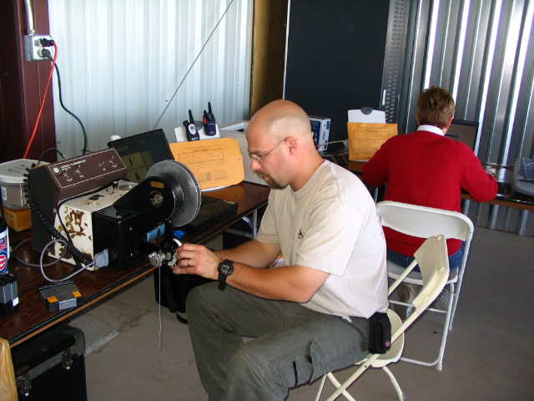
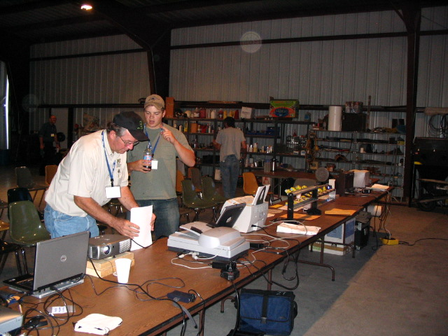
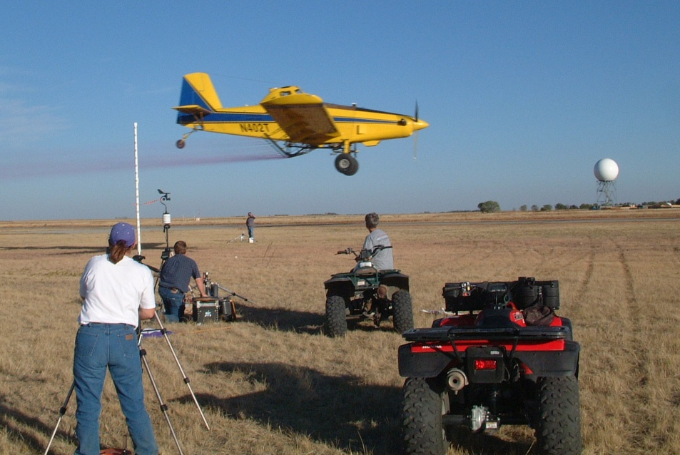
Operation S.A.F.E.
Notes:
This is a good transition slide emphasizing what the module is all about.
Self-regulating Application & Flight Efficiency
NAAA has an excellent explanation of this on the web page. Analysts and participants are both posted.
Presenters Note: Recommend Operation S.A.F.E. to all operators and pilots. Encourage them to ask their state association to conduct/sponsor an Operation S.A.F.E.

Slide 22
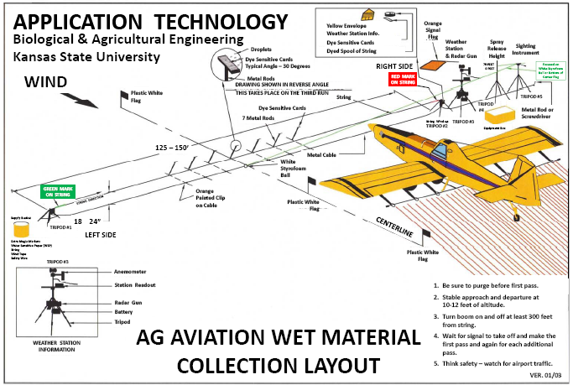
String
7 cards

Slide 23
Two sources of data – two reports
Spray pattern analysis
Fluorescent dye applied to string
Relative concentration measured using fluorometer
Used to measure spray pattern uniformity and determine appropriate swath width
Droplet size analysis
Spray droplets stain water sensitive paper cards
Stains measured using computer scanner
Used to measure droplet size and determine risk of drift and effects on efficacy

Slide 24
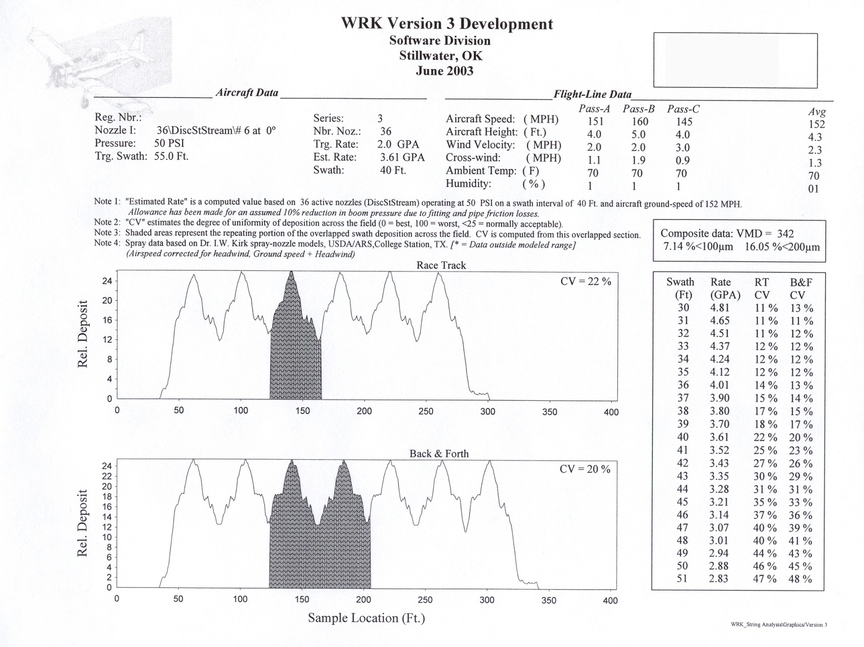
Spray pattern analysis

Slide 25
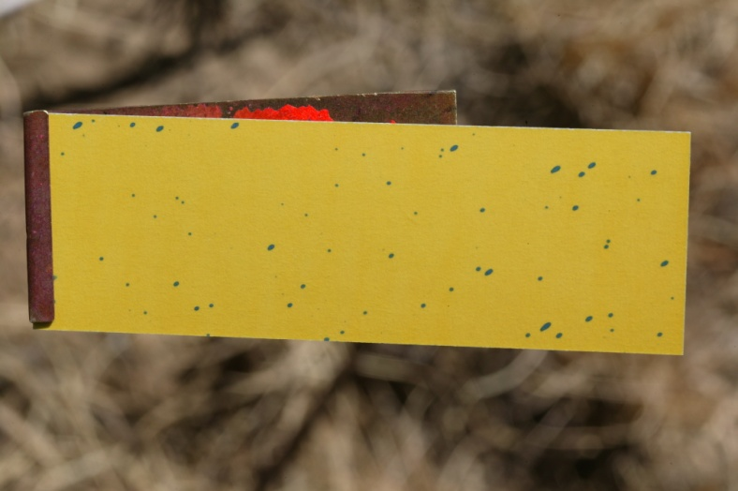
DropletScan

Slide 26
Composite droplet size data
VMD = average volume median diameter in microns
VD (0.1) and (0.9) = average volume diameter in microns for 10% and 90% of volume, respectively
GPA = average gallons per acre measured on cards
Percent coverage = average percentage of card surface area covered by stain

Slide 27
Important Droplet Statistics:
VMD
(50%)
or
Vd0.5
Operational Area
VD0.1
(10%)
VD0.9
(90%)

Slide 28
Other droplet measurement terms
VD(0.1) – droplet diameter where 10% of spray volume is smaller (90% is greater)
VD(0.9) – droplet diameter where 90% of spray volume is smaller (10% is greater)
Relative span (RS) – used to describe the “width” of the spectrum
VD(0.9) – VD(0.1)
RS =
VMD

Slide 29
Droplet size recommendations
VMD usually should be in 300-500 micron range
A smaller VMD will be required for lower GPA rates
VD(0.1) > 200 microns – reduce the risk of drift
VD(0.9) < 600 microns – prevent large droplets that can reduce coverage by consuming large portions of the total volume
RS should be around 1 - provides suitable variation for differences in target structure

Slide 30
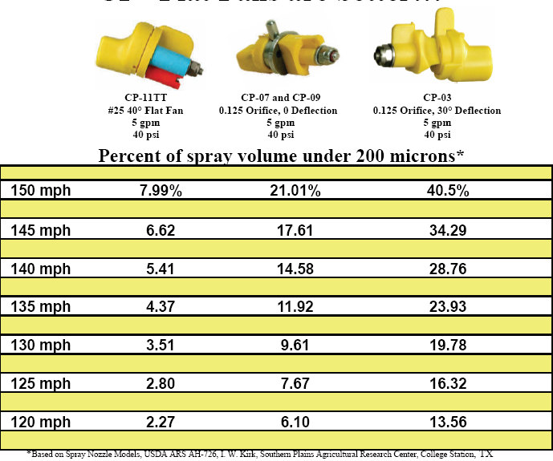

Slide 31
Calibration!!!! The next phase!
A new concept for applicators!
Ensuring that the spray droplet spectrum is what it is supposed to be to maximize efficacy while minimizing drift!

Slide 33
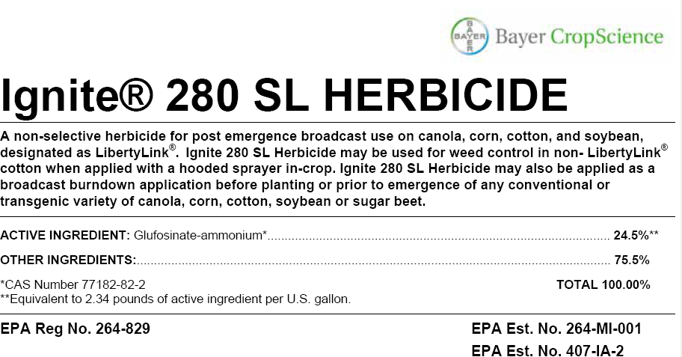

Slide 34
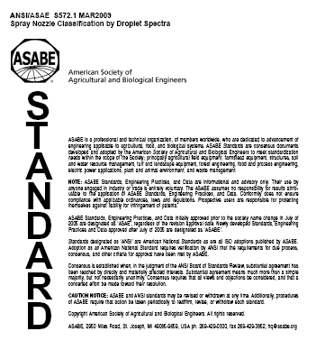
2009
ASABE S-572.1 Droplet Size Standard

Slide 35
Spray Quality Categories
ASABE Standard S-572.1
Category (symbol) | Color Code
Extra Fine (XF) | Purple
Very Fine (VF) | Red
Fine (F) | Orange
Medium (M) | Yellow
Coarse (C) | Blue
Very Coarse (VC) | Green
Extra Coarse (XC) | White
Ultra Coarse (UC) | Black
2009
NEW
S572
NEW

Slide 36
ASABE Standard
>150
Fungicides/Insecticides
151-250
251-350
351-450
Herbicides
451-550
>551
Source: CropLife – July 2002
Notes:
Summary chart with descriptions and approximate droplet sizes recommended. Important to mention the relative size so they can keep it in perspective.

Slide 37
Roadside Equipment?

Slide 40
Off-Center Venturi Flat-fan

Slide 41
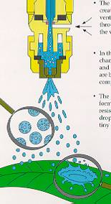
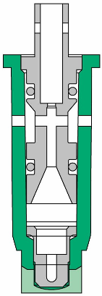
Pre-orifice Air Induction Nozzles:
Pre-orifice
Air induction
Mixing Chamber
Exit orifice

Slide 42
Boom Buster

Slide 43
XP BoomJet

Slide 44
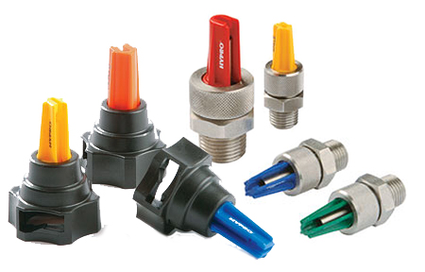
Boom Extender:

Slide 45
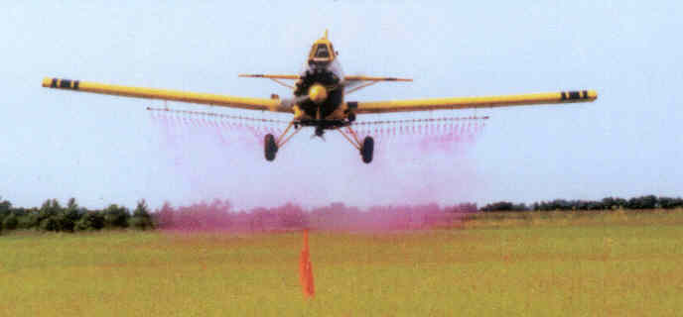
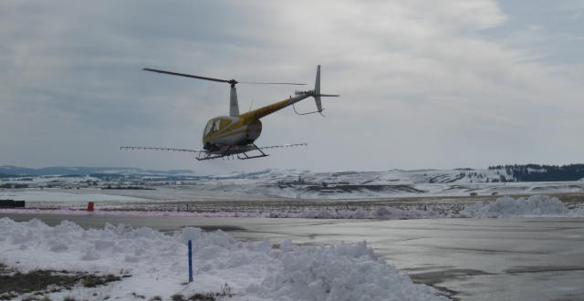
Aerial Applications

Slide 46
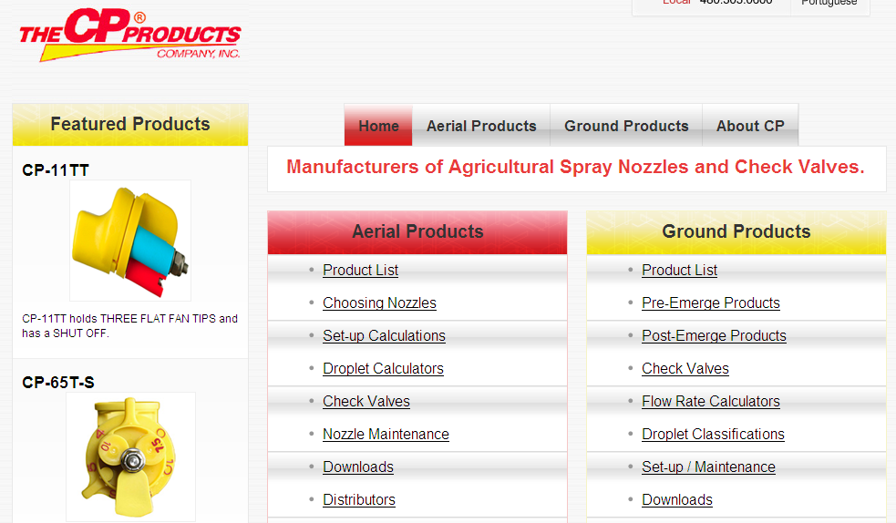

Slide 47
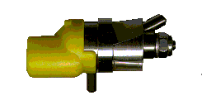
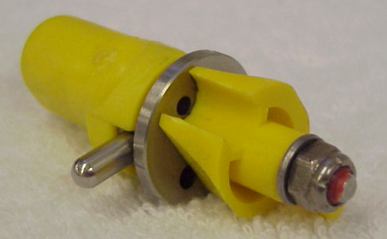
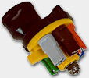
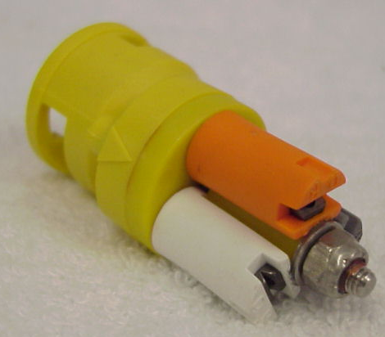
The CP STRAIGHT STREAM NOZZLE

Slide 48
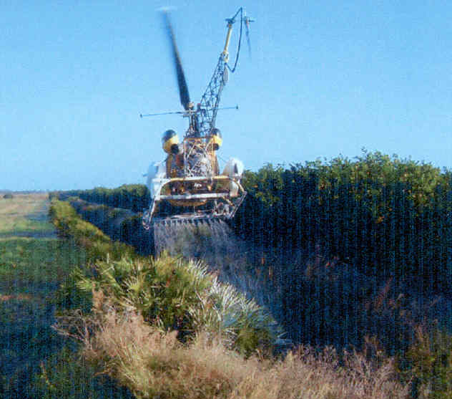
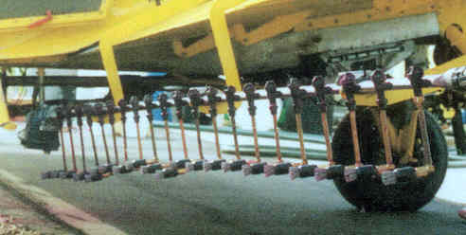

Slide 49
Notes:
The following three slides are added as a reminder of the tools available to aerial applicators to help configure the spray system to achieve the desired droplet spectra specifications. Again, these models have been the subject of previous programs so try to avoid spending much time in detail of each. Reinforce the value these models can be to the industry.
This is the CP03 USDA model – technical version. Vd.1 and Vd.9 are added as well as the graphs at the bottom to show how the droplet spectrum fits into the model. There is much more information on the technical version if one takes the time to understand the data.
The same information can be derived from the same model on the CP Products home page.

Slide 50
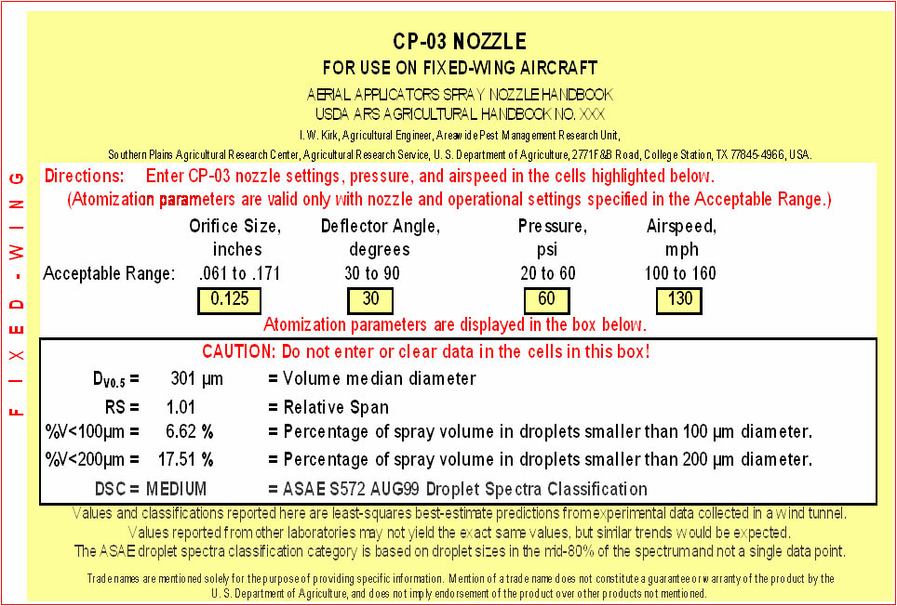
USDA Aerial Nozzle Atomization Models
Notes:
Example view. This page is not interactive, however remind the audience that the 4 yellow boxes (in the 4 red circles) can be adjusted to affect the resulting droplet spectra characteristics. With this model, operators will need to be familiar with CP-03 orifices (.062, .078, .125 and .172) available and the deflector choices (30°, 55° and 90°),. Straight stream deflectors would be 0°, 5° and 30°.
Items in the larger circle will change as inputs are adjusted. Briefly review all the terms as it relates to drift probability – VMD, RS, %<100, %<200, and DSC (droplet spectra classification).

Slide 51
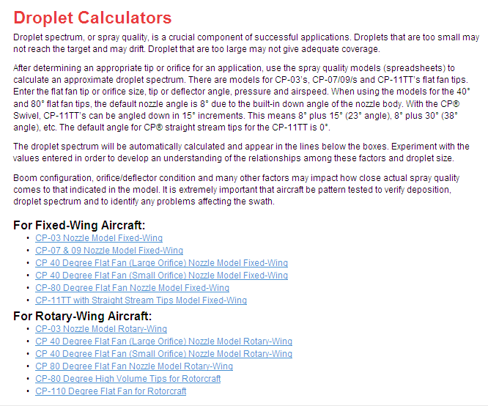

Slide 52
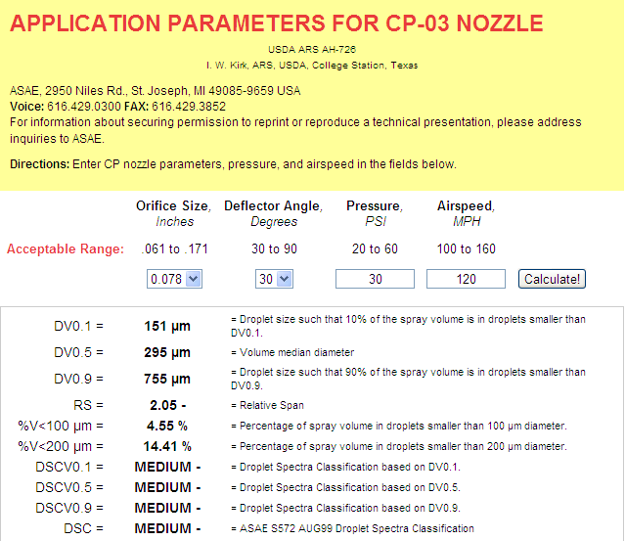
1
Fixed Wing

Slide 53
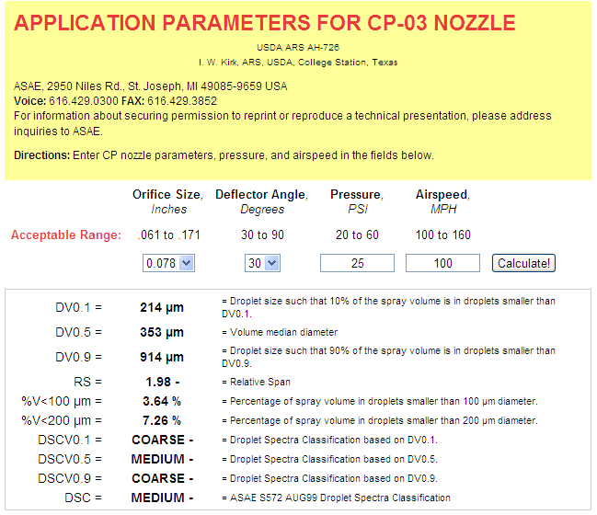
2
Fixed Wing

Slide 54
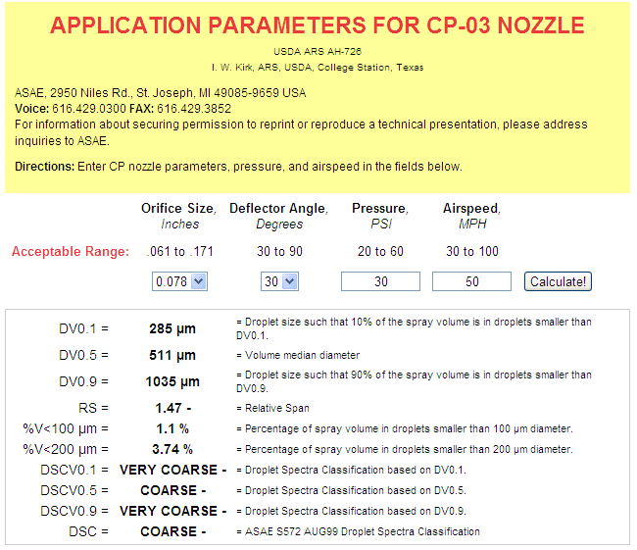
3
Rotary Wing

Slide 55
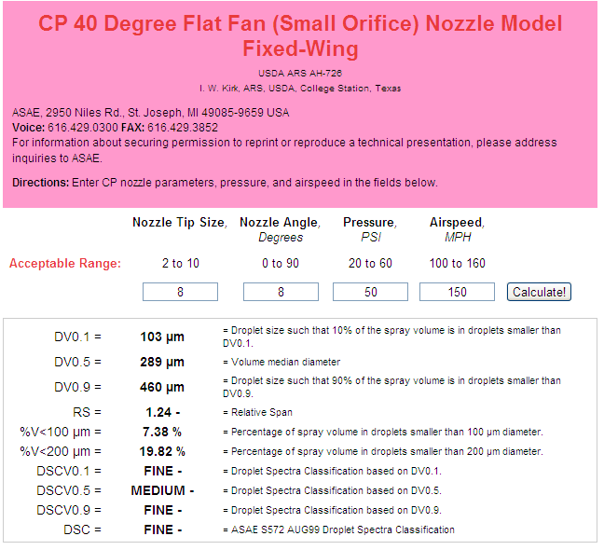
4
Fixed Wing

Slide 56
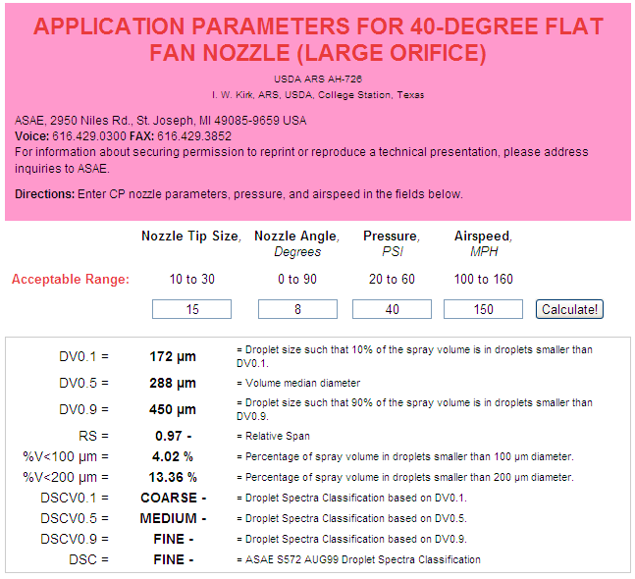
5
Fixed Wing
Notes:
This is the CP03 USDA model – technical version. Vd.1 and Vd.9 are added as well as the graphs at the bottom to show how the droplet spectrum fits into the model.There is much more information on the technical version if one takes the time to understand the data.

Slide 57
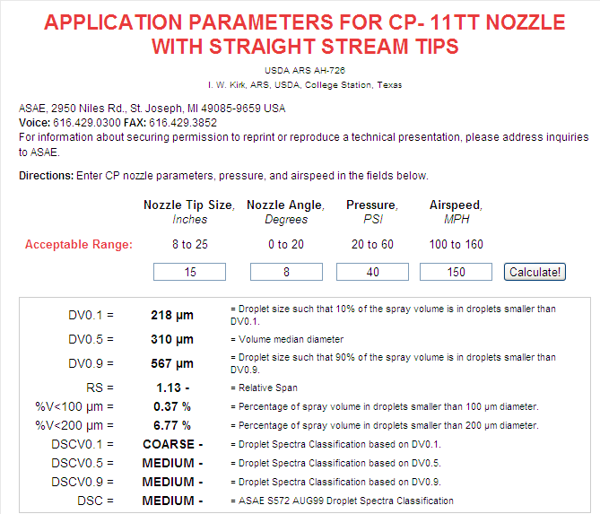
6
Fixed Wing

Slide 58
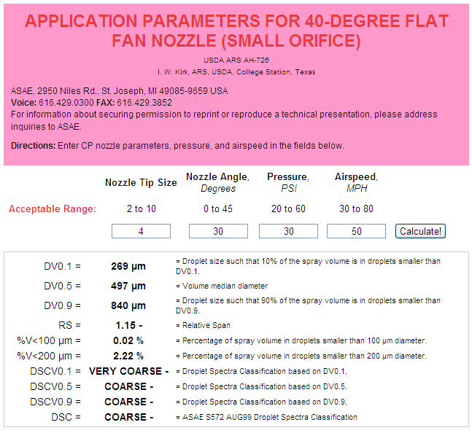
7
Rotary Wing

Slide 59
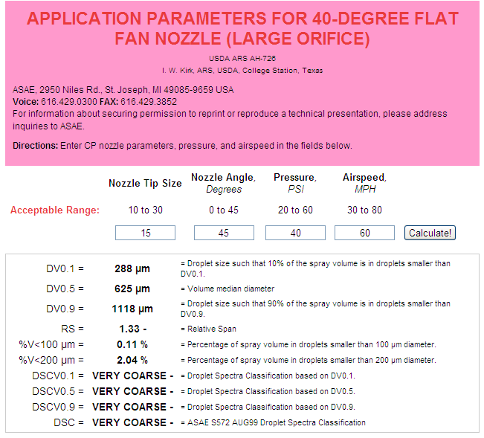
8
Rotary Wing

Slide 60
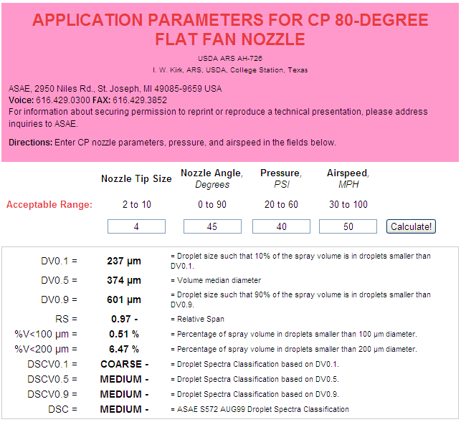
9
Rotary Wing

Slide 61
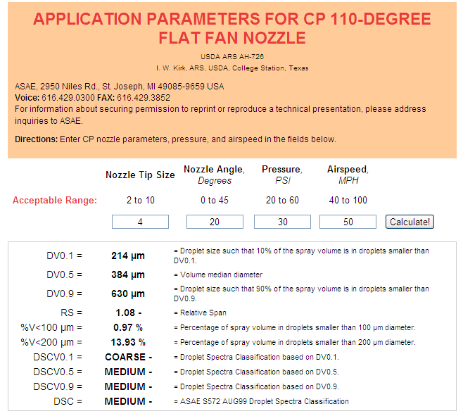
10
Rotary Wing

Slide 62
Droplet size recommendations
VMD usually should be in 300-500 micron range
A smaller VMD will be required for lower GPA rates
VD(0.1) > 200 microns – reduce the risk of drift
VD(0.9) < 600 microns – prevent large droplets that can reduce coverage by consuming large portions of the total volume
RS should be around 1 - provides suitable variation for differences in target structure

Slide 63
Drift Study

Slide 64
Drift Reduction/Deposition Aids:
Many available!
Not EPA regulated
Long chain polymers
Soluble powders
50 - 80% reduction in off-target movement
Not all will work!!!!
Pump shear problems
Effect on the pattern?
Deposition Aids

Slide 65
Product Name | Product Company | Mixing rateª
Tap water 1 | Local supply | X-77 only
Superb HC + Interlock | Winfield Solutions | 133 oz + 33 oz / 50 gal
Formula 1 | United Suppliers | 1.5 qt / 50 gal
#PX056-Z | Precision Labs, Inc | 5 qt / 50 gal
Tap water 2 | Local supply | X-77 only
Ag 06037 | Winfield Solutions | 64 oz / 50 gal
Ag 08050 | Winfield Solutions | 80 oz / 50 gal
Interlock 1.25 | Winfield Solutions | 80 oz / 50 gal
Control | GarrCo Products, Inc | 2 oz /50 gal
Tap water 3 | Local supply | X-77 only
INT 908 | Rosen’s | 5 gal / 45 gal
Tap water + Prime Oil^{b} | Local supply + Winfield Solutions | 266 oz / 50 gal
Interlock 0.8 | Winfield Solutions | 50 oz / 50 gal
ª All tank mixes included X-77 at .25% v/v (16 ounces per 50 gallon load).
^{b}Oil to simulate a suggested tank mix with fungicide (Prime Oil @ 1 pint/acre).

Slide 66
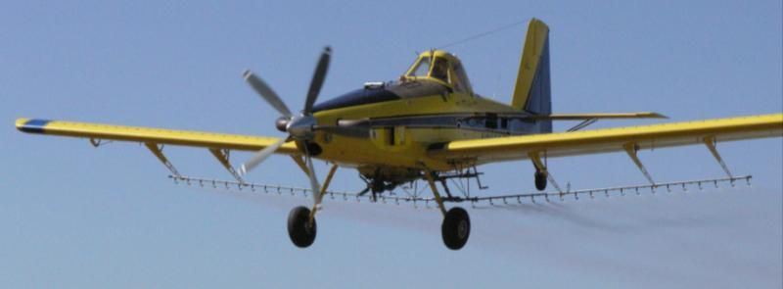
Materials and Methods (2008):
AT 502A(Rucker Flying Service)
Drop booms
CP-11TT #15 straight stream nozzles w/8° deflection
44 PSI
156 mph ground speed by GPS
Droplet spectrum: Medium, %volume <200 = 7.65%
Aircraft calibrated for 3 GPA

Slide 67
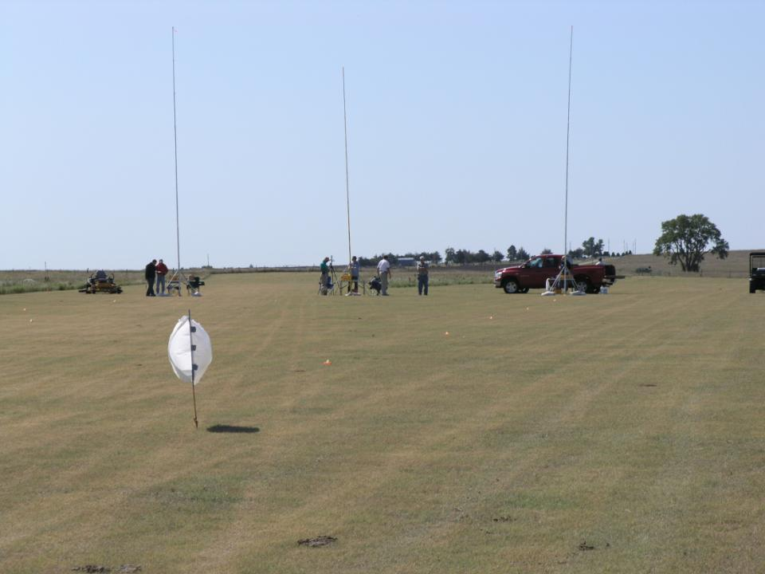
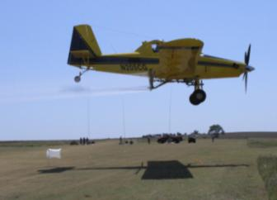
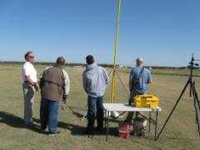

Slide 68
Total Drift Ranked:
water average
g
fg
ef
ef
bcd
cde
cde
de
% Area Coverage
abc
ab
a
a
a

Slide 69
Solution Factor:
Changes the flow rate ?????
Changes the droplet spectra !!!!

Slide 70
Droplet Studies

Slide 71
Volume Median Diameter (VMD)
% less than 210 Microns
37
51
36
35
45
23
30
14
15
26
19
22
14
13
22
10
17
29
29
15
Percent fines
40 psi 40 psi 40 psi 70 psi
Bob Klein, U of Nebraska

Slide 73
Need to evaluate droplets of solutions:

Slide 74
CP11TT4015 Flat-Fan
140 MPH
40 PSI
23 degree orientation

Slide 75
ASC D-12 Rotary Atomizer
140 MPH
26 PSI
2 GPA
Blade pitch #2

Slide 76
ASC D-12 Rotary Atomizer
Treatments
Water
Water + Quilt
Water + Quilt + Foliar Fertilizer
Water + Quilt + NIS
Water + Quilt + COC
Water + Quilt + Deposition Aid
140 MPH
26 PSI
2 GPA
Blade pitch #2

Slide 77
CP11TT4015 Flat-Fan
Treatments
Water
Water + Quilt
Water + Quilt + Foliar Fertilizer
Water + Quilt + NIS
Water + Quilt + COC
Water + Quilt + Deposition Aid
140 MPH
40 PSI
23 degree orientation

Slide 78
Disclaimer:
Brand names appearing in this presentation are for identification and illustration purposes only.
No endorsement is intended, nor is criticism implied of similar products not mentioned.

Slide 79
rewolf@ksu.edu
For more information contact:
Thanks!
www.bae.ksu.edu/faculty/wolf/

