Slide 1


Keys to Spray Drift Management
Robert E. Wolf
Extension Specialist Application Technology
Biological and Agricultural Engineering
Notes:
Use either title slide. Hide the one you do not want to use.

Slide 2
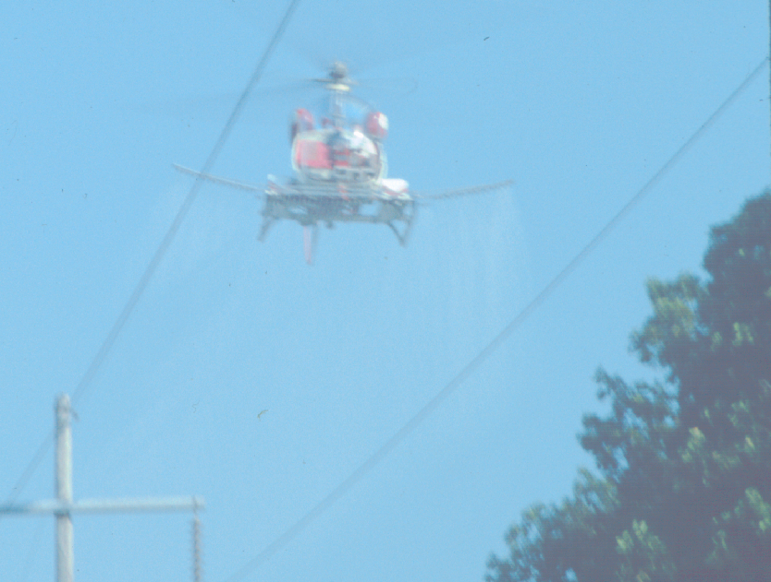
Accurate and Efficient Applications
Increase Efficacy
Minimize Drift
Maximize Productivity
Notes:
Many technological changes have occurred in the spray industry in recent years. Much attention has been given to application equipment to increase efficiency and minimize spray drift. This presentation is designed for you to share some of these application technologies in ground application with your applicator audiences. Equipment design changes have occurred in all forms of ground application. Much of the improvements has been directed at the reduction of spray drift.

Slide 3
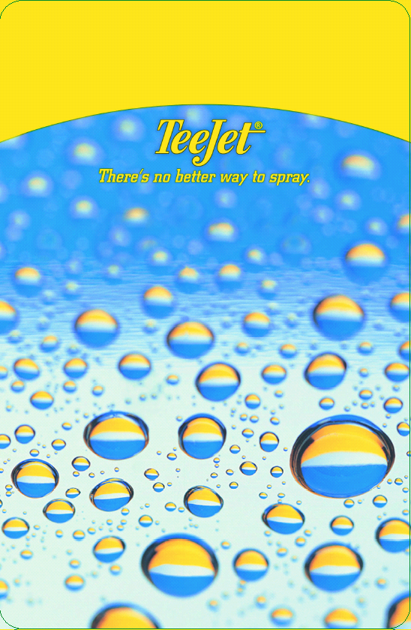

Slide 4
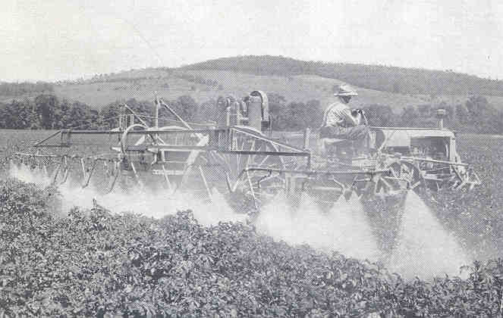
Technical Aspects of Spray Drift
Circa 1930’s USDA Bulletin

Slide 5
Plant Response
1/100 Rate of 2,4-D Simulated as Drift
14 Days After Exposure
Percent injury
Kassim Al-Khatib - Kansas State, Cal Davis

Slide 6
Cotton Response
1/100 Rate 2,4-D Simulated as Drift
14 Days After Exposure
Percent injury
Kassim Al-Khatib - Kansas State, Cal Davis

Slide 7
Definition of Drift:
  Movement of spray particles and vapors off-target causing less effective control and possible injury to susceptible vegetation, wildlife, and people.
  Adapted from National Coalition on Drift Minimization 1997 as adopted from the AAPCO Pesticide Drift Enforcement Policy - March 1991
Notes:
Drift defined. I usually focus on the particles with my talks but some of the issues with cotton may be reason to think a little more about the issues with vapors.

Slide 8
Types of Drift:
Vapor Drift - associated with volatilization (gas, fumes)
Particle Drift - movement of spray particles during or after the spray application
Notes:
Again, focus is on the particles and emphasize the ‘after’. Environmental concerns with inversions would be the reason. Later slides will illustrate the role of inversions. ‘During’ will be strongly influenced by wind.

Slide 9
Factors Affecting Drift:
Spray Characteristics
  chemical
  formulation
  drop size
  evaporation
Equipment & Application
  nozzle type
  nozzle size
  nozzle pressure
  height of release
Weather
  air movement (direction and velocity)
  temperature and humidity
  air stability/inversions
  topography
Notes:
5
All the factors that are associated with causing drift. Nothing new. However, items in red are getting new interest in research and education. The main focus of the rest of this presentation will discuss the weather related items listed.

Slide 10
Efficacy and Drift Mitigation:
Size of the Spray Droplets - Microns
  Volume Median Diameter (VMD)
Droplet Spectrum (Range - big to small)
% Volume in droplets less than
200 microns in size

Slide 11
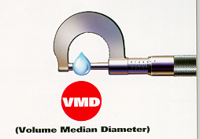
Drop Size:
One micron (μm) =1/25,000 inch

Slide 12
Comparison of Micron Sizes for Various Items: (approximate values)
pencil lead 2000 (μm)
paper clip 850 (μm)
staple 420 (μm)
toothbrush bristle 300 (μm)
sewing thread 150 (μm)
human hair 100 (μm)
150
Notes:
9

Slide 13
1/2 of spray volume = smaller droplets
VMD
1/2 of spray volume = larger droplets

Slide 14

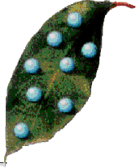
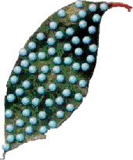
Improving Coverage or Increasing Drift?
500 microns = 1
250 microns = 8
125 microns = 64

Slide 15
Important Droplet Statistics:
VMD
(50%)
or
Vd0.5
Operational Area
VD0.1
(10%)
VD0.9
(90%)

Slide 16
Droplet measurement terms:
VD(0.1) – droplet diameter where 10% of spray volume is smaller (90% is greater)
VD(0.9) – droplet diameter where 90% of spray volume is smaller (10% is greater)
Relative span (RS) – used to describe the “width” of the spectrum
VD(0.9) – VD(0.1)
RS =
VMD

Slide 17
Relative Span
RS = (Vd.9 – Vd.1)/VMD
Vd.9 = 500, VMD = 300, Vd.1 = 200
Vd.9 = 700, VMD = 300, Vd.1 = 100

Slide 18
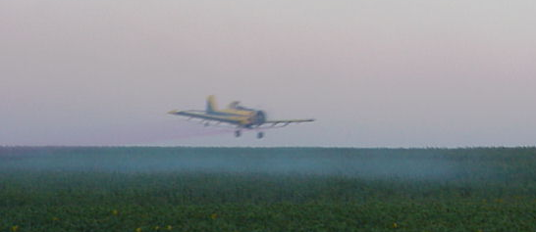
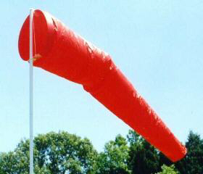
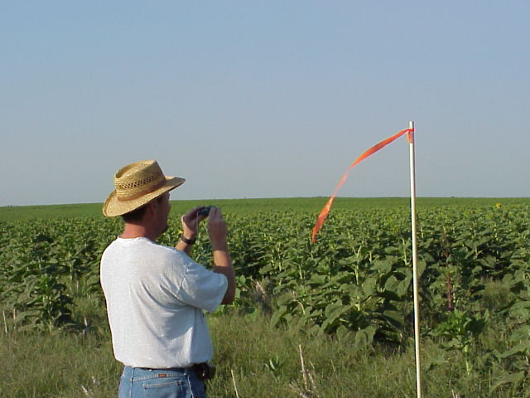
Weather factors of concern:
air movement (direction and velocity)
  Topography, etc.
temperature and humidity
air stability/inversions
Courtesy – George Ramsay, Dupont

Slide 19
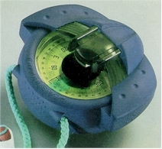
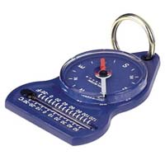
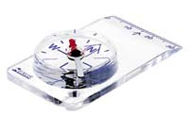
Wind direction:
Wind direction is very important
  Know the location of sensitive areas - consider safe buffer zones.
  Do not spray at any wind speed if it is blowing towards sensitive areas - all nozzles can drift.
  Spray when breeze is gentle, steady, and blowing away from sensitive areas.
  “Dead calm” conditions are never recommended.
Notes:
‘Sensitive’ is and will become an even more important factor. Obviously cotton fits the category as would bodies of water. ‘No spray zones’ or ‘buffer zones’ will become an integral part of spraying fields in the future. Wind will influence how much material moves and in what direction. Thus determining wind direction is critical. The importance of using the compass to indicate actual ‘magnetic’ direction in degrees (0 – 360 degrees) is becoming very important from a legal perspective. From what has been learned in previous legal settings it is highly recommended to make the official record in degrees rather that simply listing the direction as N – S – E – W. Direction is recorded as blowing ‘from’.
In addition, it is advised not to spray in periods when the winds are ‘dead calm’. This is related to the issues of applying chemicals during inversion conditions and will be discussed later.
Suggest they should purchase an inexpensive compass ($10 at Walmart).

Slide 20
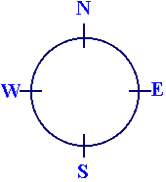
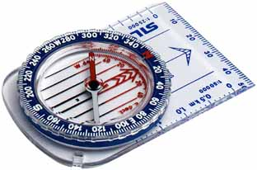
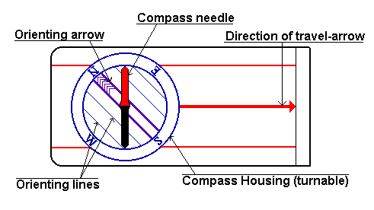
Determining wind direction:
Compass
  Provide magnetic description
  Direction blowing from
  Into your face!

Slide 21
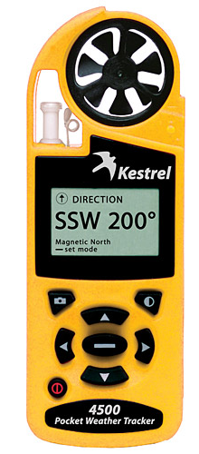
Drift Potential: High at Low Wind Speeds?
Because:
  Light winds (0-3 mph) tend to be
  unpredictable and variable in direction.
  Calm and low wind conditions may indicate presence of a temperature inversion.
Drift potential is lowest at wind speeds between 3 and 10 mph (gentle but steady breeze) blowing in a safe direction.
Notes:
When winds are light and variable it usually means that the direction they are blowing is unpredictable. This is a disaster waiting to happen in most application scenarios. As an applicator you would rather have a wind blowing strong enough to have a set direction. Then you can make better judgments regarding a particular application in reference to downwind sensitive areas. Such as not spraying, leaving a buffer and coming back when wind changes direction, etc.

Slide 22
Wind Speeds: Spray Droplet Movement
Notes:
The information presented on this slide demonstrates the effects of wind on the spray droplets. Note that the distances the droplets move are dramatically higher with the smaller droplets. As the droplet sizes increase, the distances moved decreases.
Thus, larger spray droplets have a far greater opportunity to deposit on the target area.

Slide 23
Wind Speeds Gradients:
30
20
10
6
2
0
11 mph
10 mph
8 mph
Height Above Crop Canopy, Feet
7 mph
5 mph
The relation between height above the canopy of a crop like cotton or soybean and the speed of wind.
Notes:
This diagram shows that as the height above the ground or the crop increases the velocity of the wind increases.
This is a natural phenomenon.

Slide 24
Wind Current Effects:
Wind currents can drastically affect spray droplet deposition
Structures drastically affect wind currents
  Wind breaks
  Tree lines and orchards
  Houses and barns
  Hills and valleys
Notes:
Wind and air currents can drastically affect spray droplet deposition. When the wind blows against structures, the direction of the wind currents can be drastically affected. In this discussion, structures will be used to define anything that can deflect wind flow.

Slide 25
Wind Patterns Near Treelines:
Adapted from Survey of Climatology:
Griffiths and Driscoll,
Texas A&M University, 1982
Notes:
This diagram of wind currents has several applications.
If there was a field between two tree lines then the turbulent and circular flows described could result in spray droplet deposition even in upwind areas bordering the field
If the sketch was depicting level fields with a ditch or depression, then one could understand how product was moved down into the depression by wind currents.
Areas with topographical variability-i.e, a combination of hills, valleys, woodlands-can present even greater variables which result in spray droplet deposition in areas that would be difficult to explain without these diagrams.

Slide 26
Wind Patterns Around Buildings:
Ground
Diagram of wind around a building.
Adapted from Farm Structures*
* H.J. Barre and L.L. Sammet, Farm Structures (Wiley, 1959)
Notes:
This diagram and the following one describe the flow of winds around a building or similar structure. Notice how the air swirls toward the ground on the downwind side of the building. Drifting fine droplets could easily be deposited here.
I like to use the comparison of drifting spray droplets to drifting snow during a snow storm. Ask the audience to think about how structures affect the movement of snow particles. Where the drifts deposit. Spray droplets will perform in the same way.

Slide 27
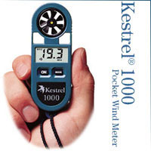
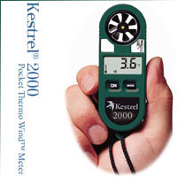
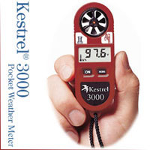
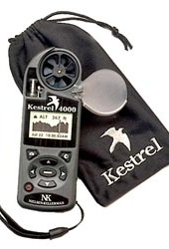
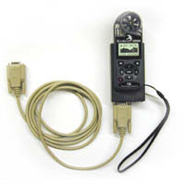
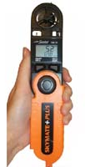
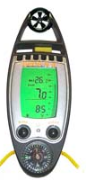
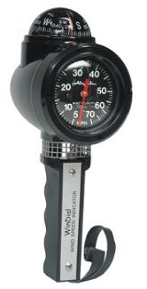
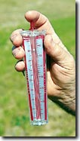
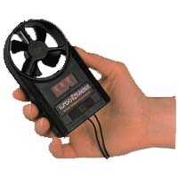
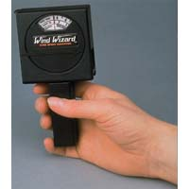
Handheld windmeters:

Slide 28
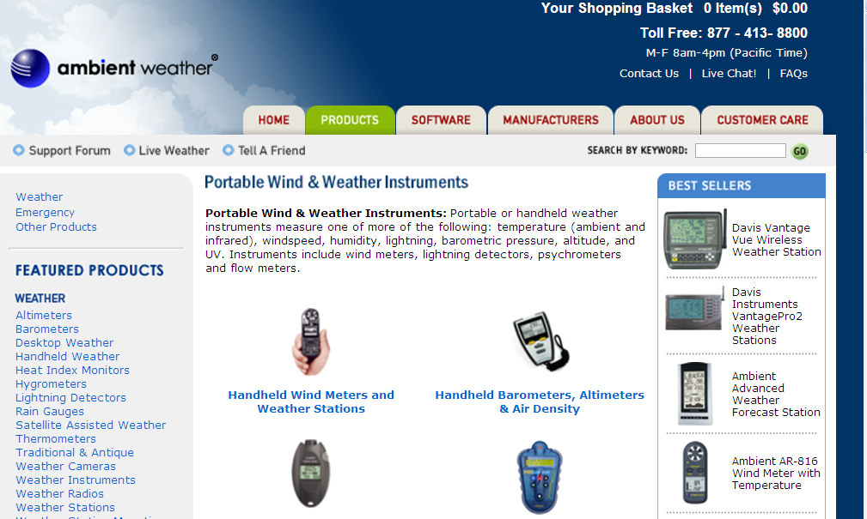
www.ambientweather.com/handheld.html

Slide 29
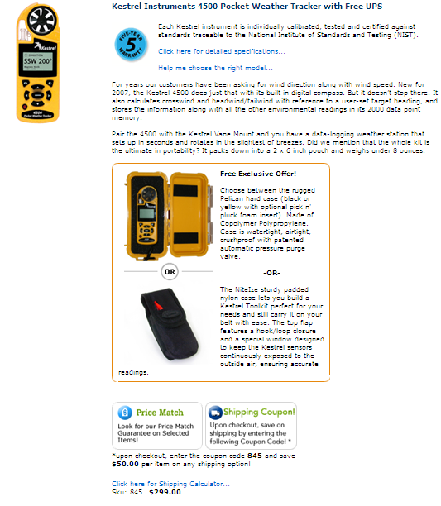

Slide 30
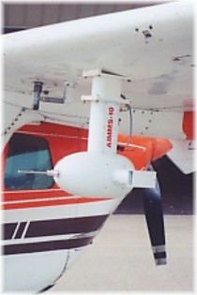
On board weather instrumentation:
Aventech Research Inc.
  Aircraft Integrated Meteorological Measurement System –AIMMS
    AIMMS-10
    AIMMS-20
      Air flow probe
      2 - measurement modules
      CPU (20 second updates)
Wind speed and direction transmitted on-board
  Used and logged
  PDA software available for real time display of meteorological conditions.
http://www.aventech.com

Slide 31
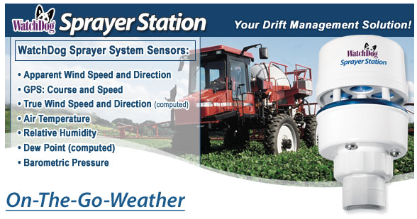
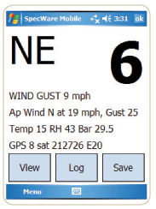
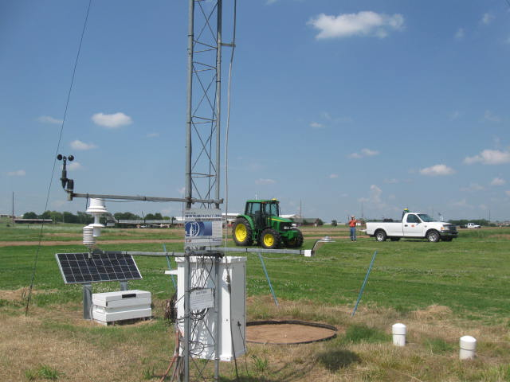
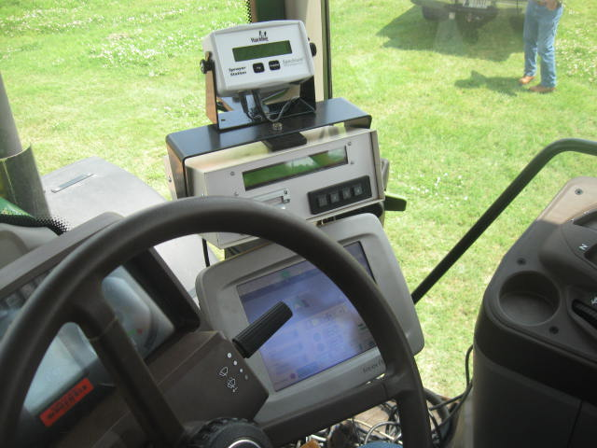
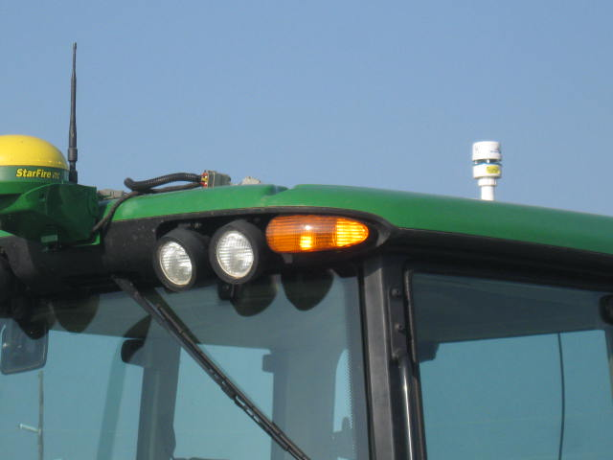
On board weather instrumentation:

Slide 32
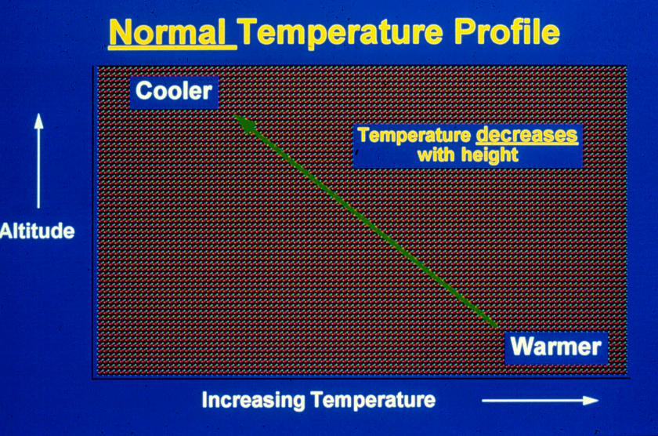
Inversions:
Under normal conditions air tends to rise and mix with the air above. Droplets will disperse and will usually not cause problems.
Normal Temperature Profile
Cooler
Temperature decreases
with height
Altitude
Warmer
Increasing Temperature
Notes:
Inversions are often very complicated to understand but are probably responsible for more drift complaints than any thing else. I try to make it as simple as possible to understand. The following two slides are simplifications of a temperature inversion. During normal atmospheric conditions the air temperature will get colder as you go higher creating a normal temperature profile.

Slide 33
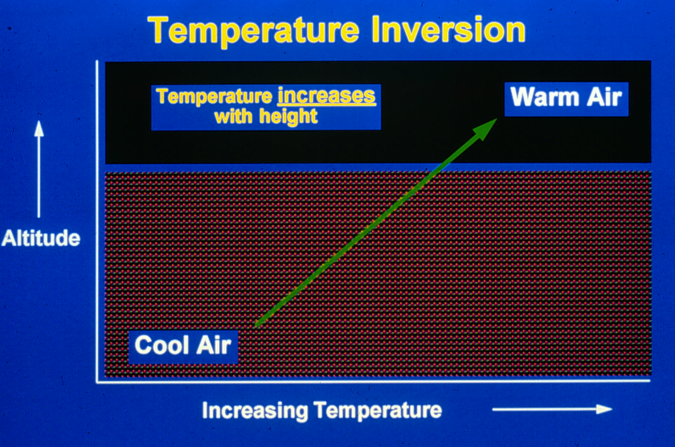
Temperature Inversions:
Under these conditions
the temperature increases as you move upward. This prevents air from mixing with the air above it. This causes small suspended droplets to form a concentrated cloud which can move in unpredictable directions.
Temperature Inversion
Temperature increases
with height
Warm Air
Altitude
Cool Air
Increasing Temperature
Notes:
During a temperature inversion a layer of warmer air may develop. This can happen at any altitude and can be a thick or thin layer. Then above the warm layer the normal cooling may occur. The layer will cause problems as indicated in the text of the slide. Usually inversion conditions occur late evening and into the morning when the winds are calm.

Slide 34
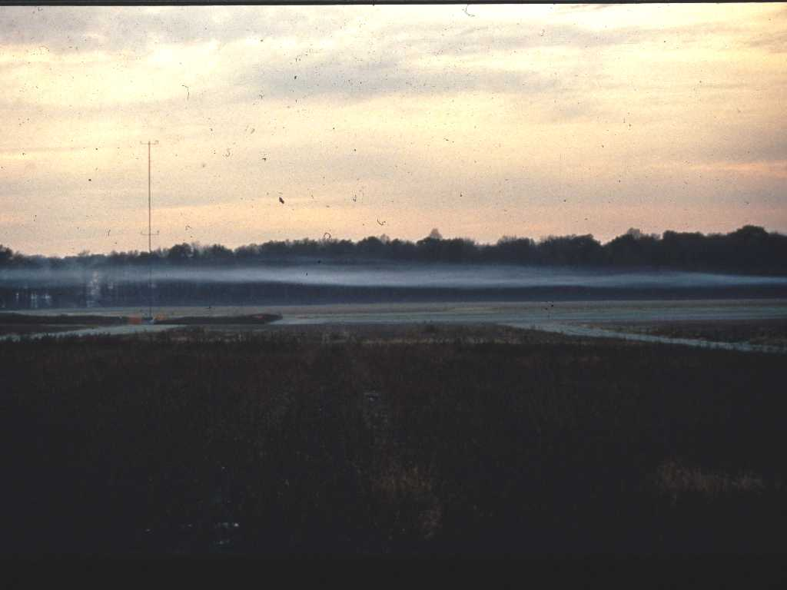
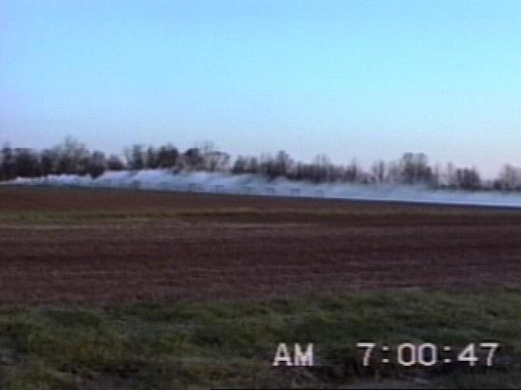
Courtesy – George Ramsay, Dupont

Slide 35

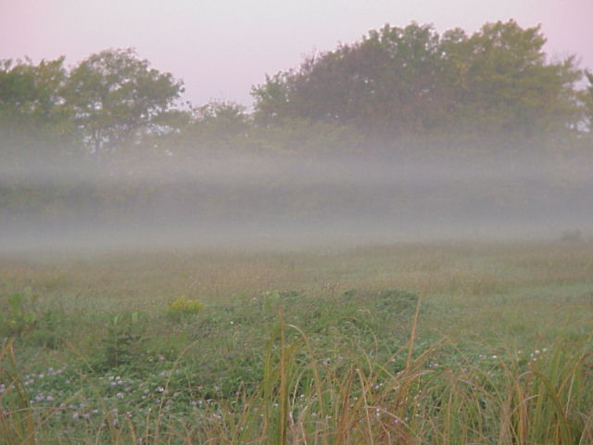
Recognizing Inversions:
Under clear to partly cloudy skies and light winds, a surface inversion can form as the sun sets.
Under these conditions, a surface inversion will continue into the morning until the sun begins to heat the ground.
Notes:
Around bodies of water, bottom ground, in valleys, and in protected areas. The lower picture actually shows a double inversion layer. Low to the ground inversion layers will trap light weight droplets. They can not fall and will not rise. They are just waiting for some wind to blow them somewhere. Pilots have to be aware of similar situations because if they spray above the inversion the spray will not all reach the target.

Slide 36
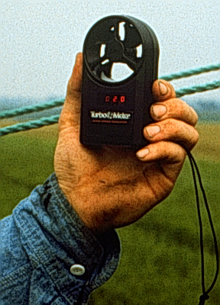
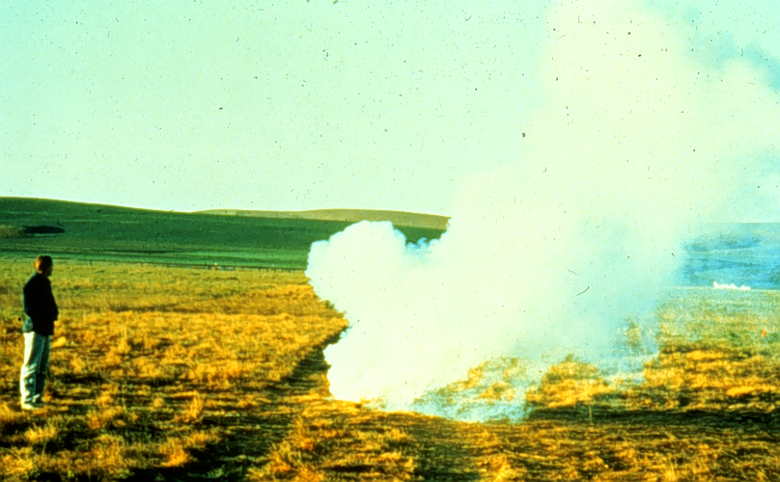
Precautions for Inversions:
Surface inversions are common .
Be especially careful near sunset and an hour or so after sunrise, unless…
  There is low heavy cloud cover
  The wind speed is greater than 5-6 mph at ground level
  5 degree temp rise after sun-up
Use of a smoke bomb or smoke
generator is recommended to
identify inversion conditions.
Notes:
So what is the problem with spraying in an inversion? Since the air is calm many of the very small spray droplets that are created during the spray process will not settle into the target area. Normally these smaller droplets would rise and dissipate into the higher atmosphere. Instead, because of the inversion layer, they are left hanging around over the field. Later when the wind picks up the droplets can move to a sensitive area. If spraying occurred at sunrise, the drift could occur 2-3 hours later when the winds pick up.

Slide 37
Evaporation of Droplets:
High Relative Humidity
Low Temperature
Low Relative Humidity
High Temperature
Fall Distance
Wind
Notes:
In addition to raising pressure to decrease droplet size the evaporation of water from spray droplets will also cause the droplets to get smaller. Evaporation will increase as temperature increases and humidity lowers. Labels will often provide cautions against spraying during high temperatures and lower humidity's. This problem can be worsened for applicators using very low GPA’s (2-3 GPA). As the droplets get smaller the wind becomes more of a factor.

Slide 38
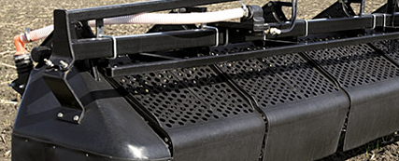
Strategies to Reduce Drift:
Select nozzle to increase drop size
Increase flow rates - higher application volumes
Use lower pressures
Use lower spray (boom) heights
Avoid high application speeds/rapid speed changes
Avoid adverse weather conditions
  High winds, light & variable winds, calm air
Consider using buffer zones
Consider using new technologies:
  drift reduction nozzles
  drift reduction additives
  shields, electrostatics, air-assist, pulse width modulation
Notes:
This list of ways to reduce drift is designed to encourage applicators to include as many of the strategies as possible into their daily application routine. One item alone may not prove successful. Many have thought the addition of drift control additives alone would be the cure all. Technological advancements are occurring that are showing promise in reducing drift. Encourage operators to be open minded regarding adoption even though many are coming with hefty price tags. The price of a drift claim as a comparison should always be kept in mind.
We can not eliminate drift, but by using good management and adopting spray practices with drift reduction in mind, improvements will occur.

Slide 39
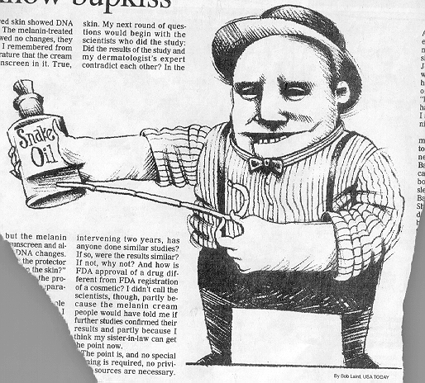
Drift Reduction Additives:
Many available!
Not EPA regulated
Long chain polymers
Soluble powders
50 - 80% reduction in off-target movement
Not all will work!!!!
Pump shear problems
Effect on the pattern?
Deposition Aids

Slide 40
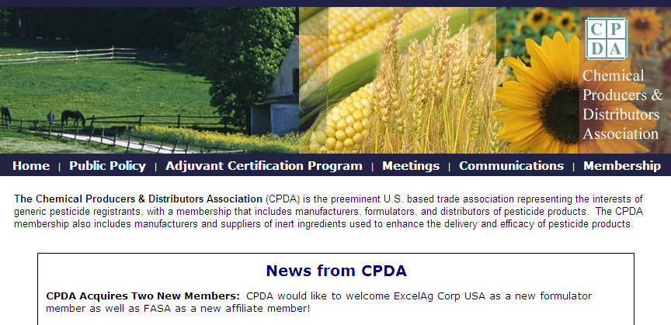
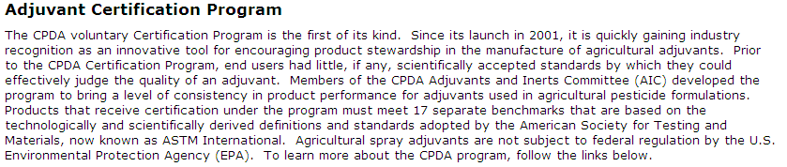

Slide 41
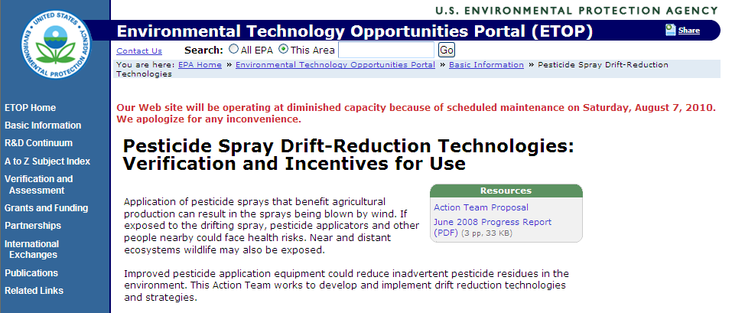
DRT

Slide 42
EPA Requested Changes on the label
2001
Guidance to Chemical Manufacturers
Better information on the label for applicators on mitigating drift.
Match crop protection products to target.
Adopt droplet standard (1999)
  ASABE S-572
Buffer Zones or No Spray Zones
Maximize Efficacy - Minimize Drift

Slide 43
EPA’s New Emphasis With
Spray Drift Reduction
Drift Reduction Technology Program – DRT (2006)
  Encourage the adoption of technology designed to reduce drift.
  Use of a testing approach to generate high quality peer-reviewed data for DRTs, including test design and quality assurance (QA).
Example technologies:
  Spray nozzles – reduce fines
  Sprayer modifiers – shields, hoods
  Spray delivery assistance – air-assist
  Spray property modifiers – formulations, drift control
  Landscape modifications – hedges, shelterbelts
Rating -

Slide 44
Relationship Between Application Technologies, Amount of Drift/Risk, and Risk Management
No DRT
DRT*
DRT**
DRT ***
Amount. of drift and risk
Level of concern for a pesticide for people, animals, plants
Distance from application site

Slide 45
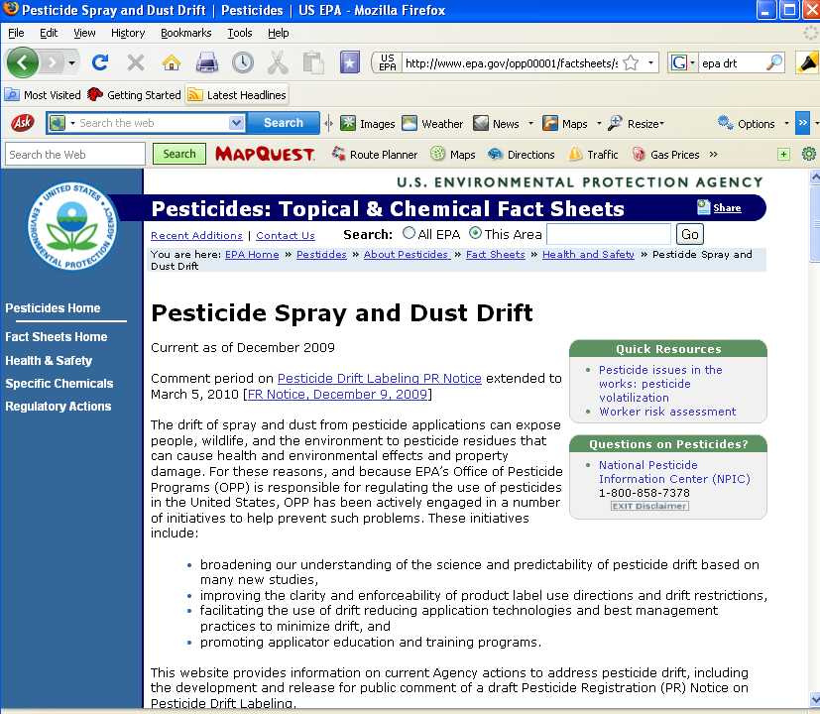

Slide 46


Slide 47
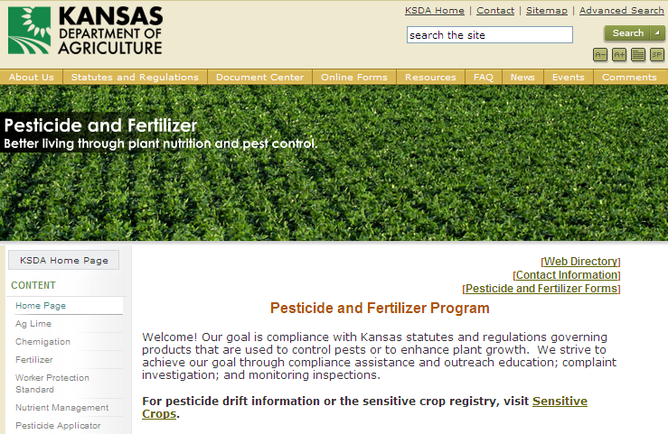
http://www.ksda.gov//

Slide 48
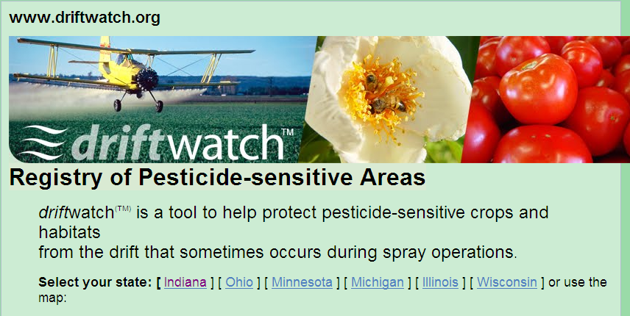



Slide 49

NPDES

Slide 50
NPDES: The Details
National Pollutant Discharge Elimination System.
  Clean Water Act permit to control ‘Point source discharges’ of pollutants in the ‘waters’ of the US.
    Factories, feedlots, etc.
  Excluded pesticide applications on or near water – EPA 2006
Jan. 7, 2009 – the 6th Circuit Court vacated the 2006 EPA rule.
  Sprayers would now be considered point source pollutant.

Slide 51
In Conclusion:
Minimizing spray drift is in the best interests of everyone. Do your part to keep applications on target.
Notes:
‘Everyone’ means all those involved in the crop protection industry – not just the person driving the sprayer.

Slide 52
Disclaimer:
Brand names appearing in this presentation are for identification and illustration purposes only.
No endorsement is intended, nor is criticism implied of similar products not mentioned.

Slide 53


For more information contact:
rewolf@ksu.edu
Thank You
www.bae.ksu.edu/faculty/wolf/

