Slide 1

Evaluation Of New Venturi Nozzle Designs For Improving Herbicide Efficacy
Robert Wolf
Biological and Agricultural Engineering Dept.
Dallas Peterson
Department of Agronomy

Slide 2
Nozzle Efficacy/Drift Slope
1980
30 years
Reducing Spray Drift
Extended Range
Nozzle development timeline
XR, TR
Turbo Flood
Turbo TeeJet
Air Mix
AI XR
GuardianAir
AI
Ultra Low Drift
Turbo Drop
TTI
Chamber Design
Venturi Design - II
Venturi Design - I
Efficacy
2009

Slide 3
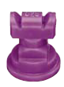
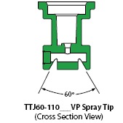
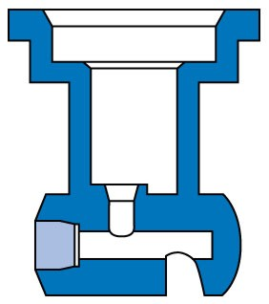
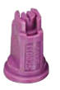
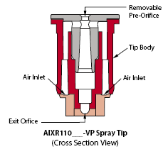
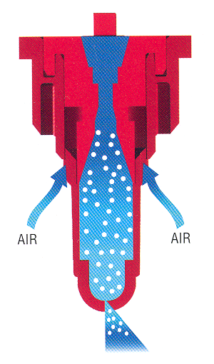
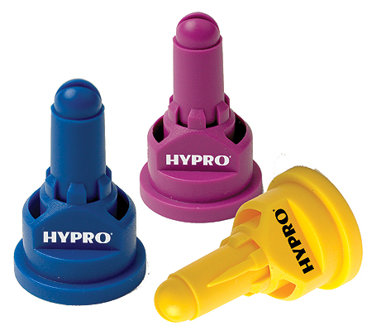
New Test Nozzles
Turbo TwinJet
AI XR TeeJet
GuardianAir - Hypro

Slide 4
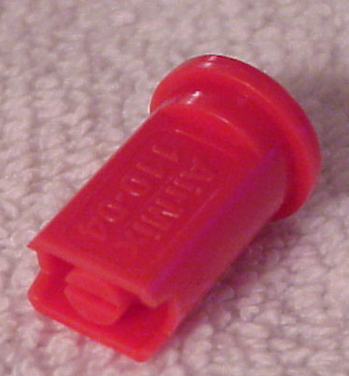
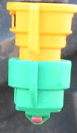
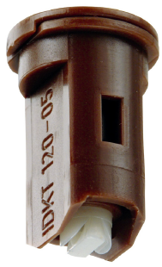
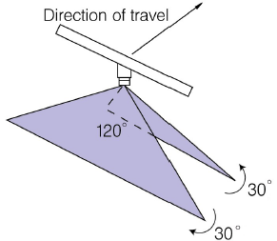
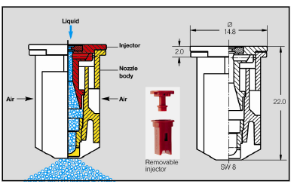

New Test Nozzles
Air Mix & TDHSTF- Greenleaf
Leckler

Slide 5
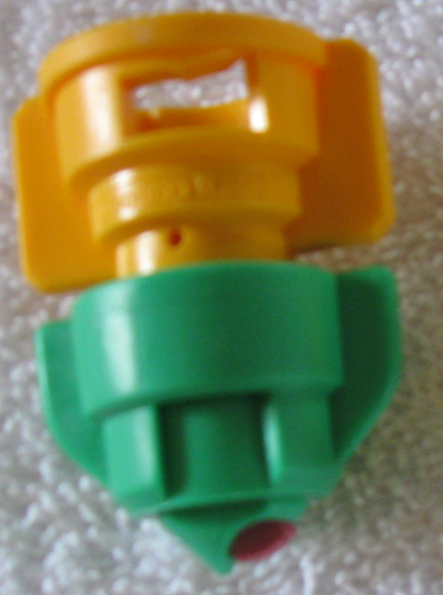
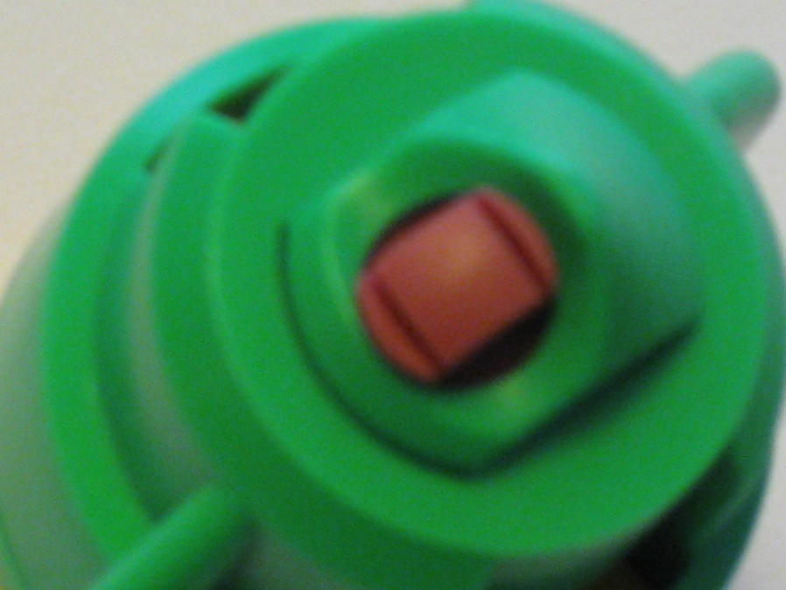
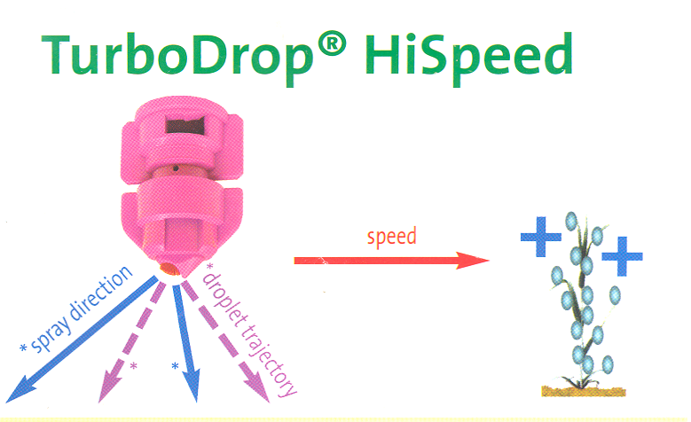
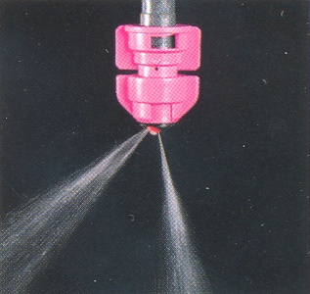


Slide 6
Objective
The objective of this study was to evaluate herbicide efficacy comparing multiple nozzle types designed to reduce drift while maintaining adequate efficacy.

Slide 7
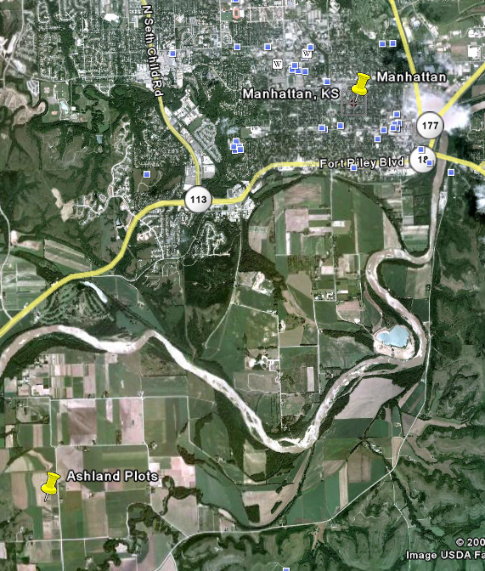
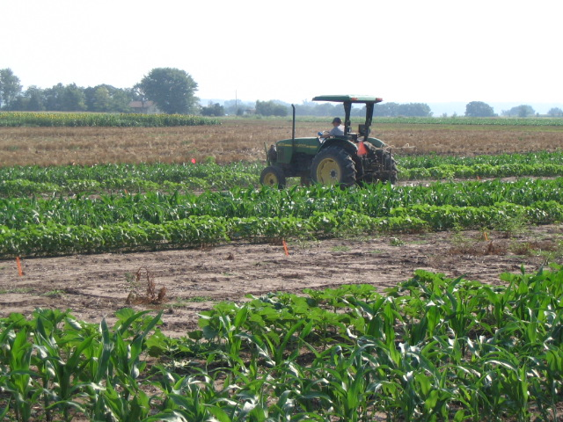
Ashland Bottoms Agronomy Research Station

Slide 8
Materials and Methods
Experiment: Agronomy Farm Ashland Field Plots
Design: 2008 - 8 x 2 RCB with split plot and 3 reps
Design: 2009 - 9 x 2 RCB with split plot and 3 reps
Main plot: Herbicide
Subplots: Spray tip by pressure
Plot Size: 3 x 9 m
Species 2008: velvetleaf, common sunflower, sorghum, corn
Species 2009: velvetleaf, ivyleaf morningglory, sorghum, corn
Visual Ratings:28 days after treatment (DAT)
Herbicides (2): Gramoxone Inteon, 0.42 kg ai/ha, NIS at 0.5% v/v
Roundup Power Max, 0.42 kg ae/ha, NPAC AMS @ 5.0% w/w
Spray Volume:70 l/ha (7.5 GPA)

Slide 9
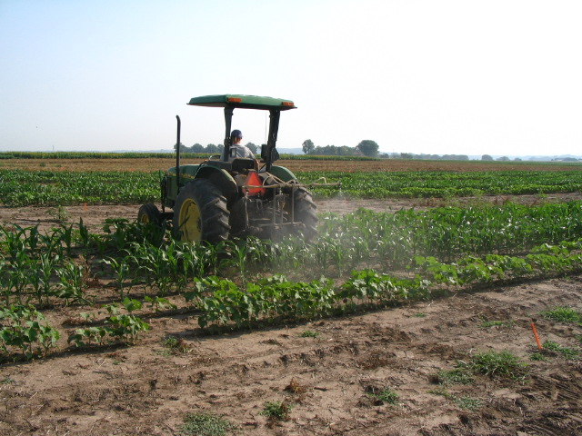
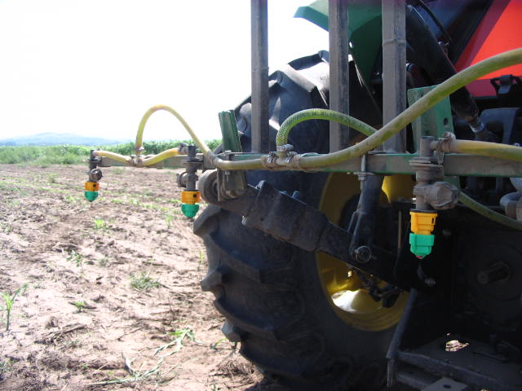
Materials and Methods
Speed: 16 km/h (10 MPH)
Tractor mounted 3-point sprayer
3 meter boom with 4 tips
Nozzle Spacing: 51 cm
Boom Height: 51cm

Slide 10
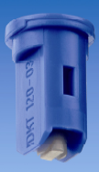

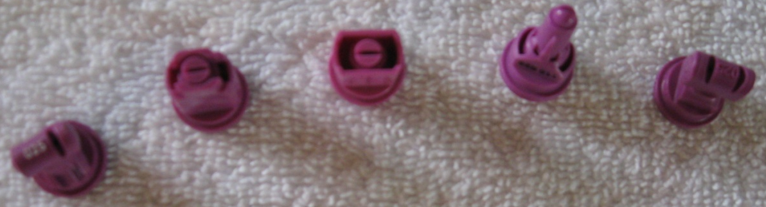
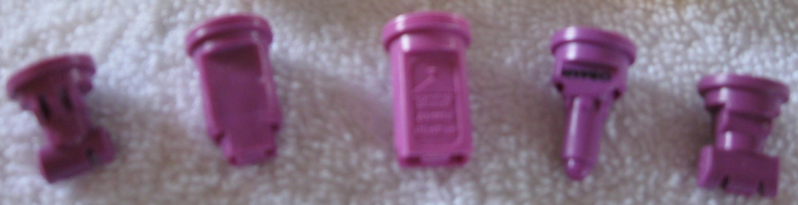
Materials and Methods
28 PSI
70 PSI
*
Twin-fan IDK-T
Turbo Flat-fan (TT)
AIXR Flat-fan
Air Mix (AM)
Guardian (GA)
Turbo Twin Flat-fan (TTJ60)
AIC Flat-fan
TDHSTF
Ultra Lo Drift (ULD)
*
*
40 PSI
*
*

Slide 11
Percent Control by Nozzle Type
Glyphosate - 28 DAT
a
a
a
a
a
a
a
a
a
ab
ab
ab
ab
ab
ab
abc
abc
abc
abc
bc
bc
bc
c
c
c
c
c
c
c
2009

Slide 12
Percent Control by Nozzle Type
Paraquat - 28 DAT
a
a
ab
abc
ab
ab
ab
abc
b
abcd
b
abc
b
abc
ab
abcd
bcd
abcd
cd
b
e
c
c
c
c
c
c
c
2009

Slide 15
Summary
For glyphosate, the AIXR and TT had best control.
When comparing similar nozzle designs, the twin-fan IDK-T performed better than the twin-fan TTJ60 and TDHSTF.
Within the new venturi designs, the AIXR outperformed the AM and GA.
For the old style venturi designs, the AIC and ULD performed the same.

Slide 16
Summary
For paraquat, the twin-fan TTJ60 had the best control, followed by the IDK-T, also a twin-fan.
The AIC was next, followed by the AIXR and the AM.
The TDHSTF, ULD, TT, and the GA had the lowest control.
When comparing similar designs:
  with the twin-fan designs, TTJ60 and IDK-T outperformed the TDHSTF.
  with the single outlet, TT was outperformed by the double outlet TTJ60.
  with the new style venturi designs, the AIXR and AM performed better than the GA.
  For the old style venturi designs, the AIC performed better than the ULD.

Slide 17
Conclusions:
For both years, species control varied between glyphosate and paraquat.
Differences in control with glyphosate across nozzle and species had little differences.
With paraquat, in both years mixed results with some differences were found across all nozzle types and species.
In 2009, for the paraquat treatments, the broadleaf species control was much better than the grass species control.
How to use????

Slide 18
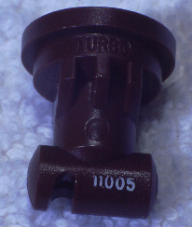

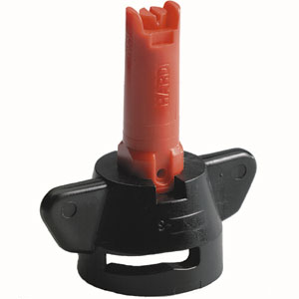
Nozzles-Recommended Use
flat spray
20-25 PSI
chamber
30-40 PSI
IN BETWEEN VENTURI
40 PSI
air induced/venturi
50-80 PSI
Notes:
Beginning with the ‘extended range’ flat fan nozzle (all major manufactures have one), continuing with the design of ‘preorifice inserts’ and ‘turbulation chambers’, and now with the ‘venturi’ style nozzle design, nozzle manufacturer's have worked to develop nozzles that are improving the quality of spray emitted.

Slide 19
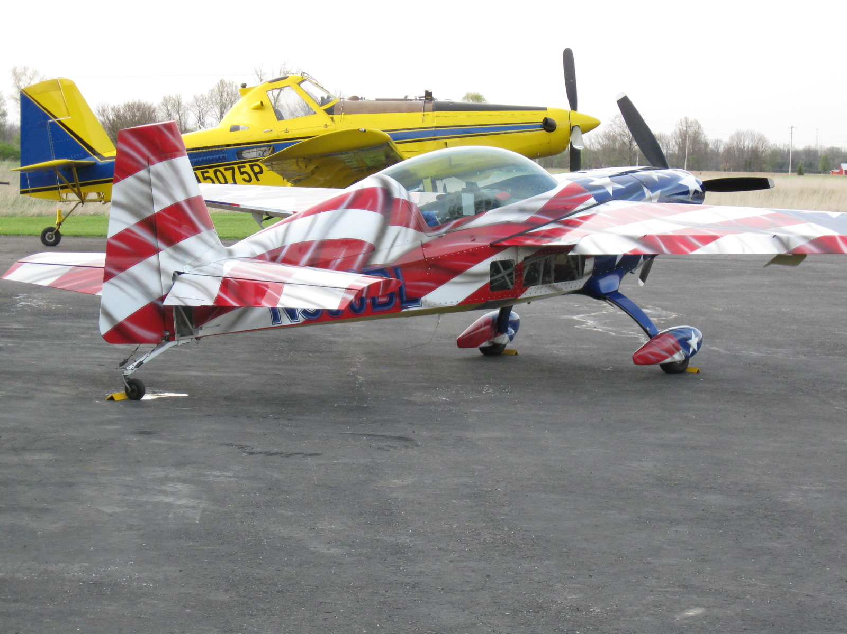

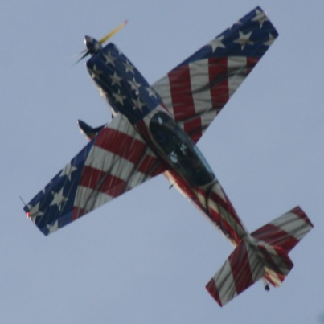
rewolf@ksu.edu
For more information contact:
Thanks!
www.bae.ksu.edu/faculty/wolf/

